Slide 1
Reshaping Power Generation New EPA Rules and NAAQS
CPES Energy & Environmental Conference
March 14, 2012, Cromwell Ct
Robert V Bibbo, Normandeau Associates

Slide 2
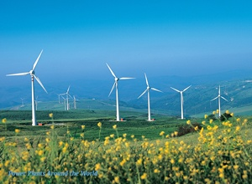
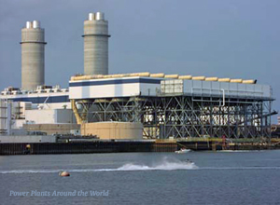
The Leading Contenders Carbon free Wind and Clean Natural Gas
Wind Turbines
Combined Cycle NGas

Slide 5
New National Ambient Air Quality Standards and EPA Rules Impacting EGUs
CAA
Nitrogen Dioxide (NO2) 100 ppb, NAAQS
Sulfur Dioxide (SO2) 75 ppb, NAAQS
Pressure PM2.5 and Ozone NAAQS more stringent
Rules for GHG emissions (Tailoring Rule &NSPS)
Mercury Air Toxics Rule (MATS) or Utility MACT
Cross State Air Pollution Rule (CSAPR V1)
CWA
316(b) Rule for Cooing Water Intake Structures
Effluent Guidelines for Waste Water Discharges
RCRA
Coal Combustion Residual (CCR) Rule

Slide 6
New SO2 and NO2 NAAQS Create a Nonattainment Hazard
1. Attainment (region is attaining a NAQQS SO2, PM2,5 NOX)
- PSD-NSR permitting rules apply
- BACT (best available technology with a consideration of cost)
- Compliance with NAQQS, Increments and AQ values
2. Nonattainment --NA (region is not attaining a NAAQS)
- NA-NSR permitting rules apply
- LAER (lowest achievable emission rate technology with no consideration of cost)
- Purchase of emission offsets at ratios greater than unity
- Demonstrate progress toward attaining the NAQQS3.
3. NA Pollutants of concern---S02, NO2 (on&off balance sheet)
4. AQ modeling can create hidden (off balance sheet) NA liabilities.

Slide 7
Rules for GHG (CO2) Emissions Tailoring Rule and NSPS
Final Tailoring Rule: Compliance for all Units July 2011
Major Source 100,000 TPY (new and existing)
Modification is Major if 75,000 TPY or greater
10 mw of coal
20 mw of NG
New Major or Major Modification
PSD Permit –Best Available Control Technology (BACT) improved efficiency, fuel switch, sequester CO2
NSPS: Final Rule Expected May 2012
Best system of emission reduction
Establishes starting point for BACT
Allows EPA to establish performance guidelines for existing sources for states to address in SIP process.

Slide 8
Mercury (Hg) Air Toxics Standard (MATS) Formerly Utility MACT
Final Rule 12/2011 (hazardous pollutants or air toxics)
Coal and oil-fired power plants are covered by this rule
All hazardous air pollutants must have standards
Standard at least as stringent as the emission reductions achieved by the average of the top 12% best controlled sources in a source category
New Plants must match the best performing source in category
Compliance is 3 years with a 4th from state agency discretion is possible. A 5th from EPA through AO if reliability is in jeopardy (should be very difficult)
Revises NSPS for new coal and oil-fired power plants

Slide 9
MACT Standards for coal and oil-fired EGUs
1. Mercury (Hg)
Hg limit (coal), part of metal air toxics limit (oil)
2. Acid Gases limits (HCL, HCL and HF)
3. Metal air toxics limit (filterable particulate)
4. Toxics Organics through work practice standards rather than numerical limits
4. Remedies to meet limits (cleaner coal, FF, ESP, activated carbon, lime duct injection, repowering to NGas CCGT). For oil, use ultra low distillate, switch to NGas , add on controls?
5. Major Concern --New MACT and Tailoring Rule limits will discourage new coal plants.

Slide 10
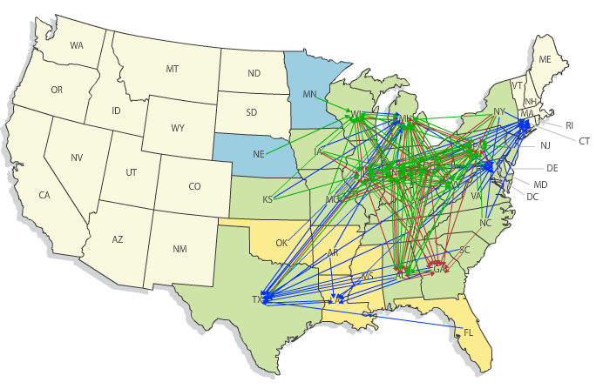
Cross State Air Pollution Rule CSAPR

Slide 11
Cross State Air Pollution Rule (CSAPR) Version 1 (V1) July 2011. Rule stayed on 12/30/2011
CSAPR V1 (2012, 2014)
System of annual and seasonal allowances
V1--1997 Ozone NAAQS and PM2.5 NAAQS. Reduce S02 by 73% and NOx by 54%. Based on a system of annual and seasonal allocations.
CSPAR V2 &V3 likely for 2008 Bush Ozone Std and 2013 std, revision of annual PM2.5 std.
Application of FGD (SOx) and SCR for NOx, cleaner coal, conversion to NGas

Slide 12
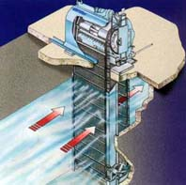
316(b) Rule Under Clean Water Act Cooling Water Intake Structures (CWIS)
Draft rule in comment Phase
Final rule expected July 2012
Minimize adverse impacts on adult fish, juvenile fish (impingement), small juveniles, fish larvae, fish eggs and larvae(entrainment) through location and design of CWIS
Affects 670 EGUs mostly (B10, ACC and SEC)
Performance standards for Impingement
- flows > 2MGD
- use of Ristroph screen and fish return
to limit fish mortality>>>>>>>>>>>>>>

Slide 13
316(b) continued
Performance Standards for Entrainment
- actual flow of 125MGD
- no best technology available (BTA)
declared
- case by case determination
- cost and benefits can be considered
The solution is cooling towers

Slide 14
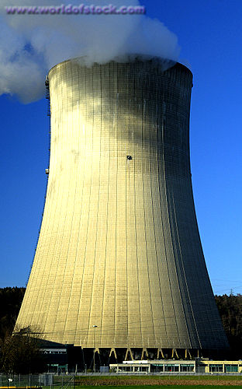
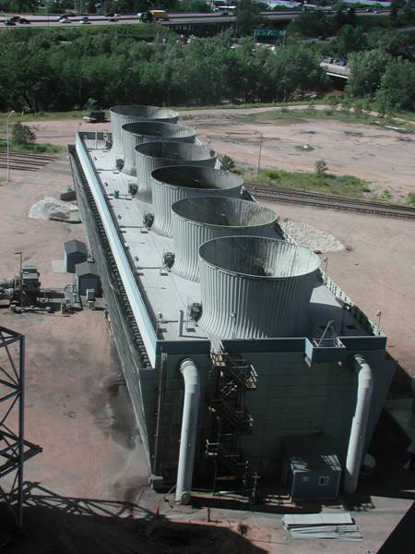
Cooling Tower Options

Slide 15
Stricter Effluent Standards for PP (CWA) Coal Combustion Residuals (CCR) Rule (RCRA)
Effluent Standards Under Development
- NOPR 07/12 Final Rule Post 2015
- Toxic metals in waste waters from coal activities, FGD, cooling towers, and chemical use is the motivator
- apply treatment technologies to meet stricter limits
Coal Combustion Residuals Rule (final post 2015)
- option 1: treat as a special -hazardous waste subject under
requirements of sub title C of RCRA
- option 2: treat as a non-hazardous waste sub D of RCRA
EPA sets performance standards
states responsible for enforcement
Engineering specs for liners, GW monitoring and SS similar

Slide 16
Projected Retirements
UBS # units MWs
SNL # units MWs
2011 (57) 31 3366
2012 (55) 21 2775
2013 (54) 16 2536
2014 (57) 39 8543
2015 (59) 22 3777
2016 (54) 9 1875
2017 (51) 9 1469
2018/20 (57) 11 1645
(56) 158 26918
2011 (53) 29 3151
2012 (55) 25 2973
2013 (51) 18 2536
2014 (54) 49 8543
2015 (58) 29 3739
2016 (56) 12 1875
2017 (59) 7 1038
2018/20 (55) 12 2577
(55) 181 26432

Slide 17
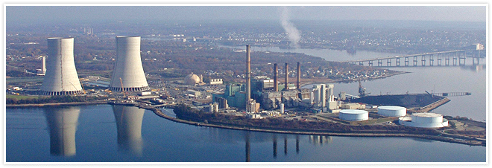
Brayton Point Power Plant 1530MW (1095 Coal, 437 NG/O)
1.1 Billion in Environmental Controls
$713 /kw (800-1000 /kw new NGCC, 400 kw for used )
Natural Draft Cooling Towers
Air Pollution Controls for SOX, NOX, Hg and GHG

Slide 18
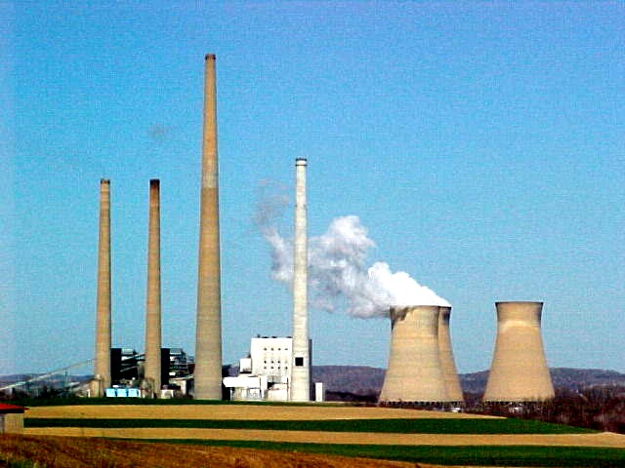
Homer City Generating Station (PA) 1900 MW Coal
$700 million Upgrade for MATS and CSAPR $368/kw

Slide 19
New England Retirements 32,000MW Fleet (30% coal and oil)
NERC 4000 MW at risk
ISONE 3300 - 5300 MW at risk
ISONE 1000 MW due to MATS/MACT
Hart Bus.com 9000MW replacements by 2021
CTDEEP Factoring Retirements into 2012
IRP
General Buzz Integration of Ngas and wind
replaces retired oil and coal

