Slide 1
Natural Gas Infrastructure Projects CPES Dinner - June 14, 2017
Christopher Luca
Manager – Project Management
Natural Gas Expansion

Slide 2
Executive Summary
We’re going to cover….
Comprehensive Energy Strategy
Gas Expansion Tools
Residential Gas Expansion - Project Overview
Gas Growth Economics
Gas Expansion Project Selection
Panel

Slide 3
Comprehensive Energy Strategy
Covers all fuels in all sectors with a planning horizon out to 2050
Advances the Governor’s agenda of moving Connecticut towards a cheaper, cleaner and more reliable energy future
25-Year Hurdle Rate Model
System Expansion (SE) rates
SER rate mechanism
Allocation of Non-Firm Margin (“NFM”) for expansion projects
Defines “Portfolio” projects
Pre-construction requirements (customer commitments)
Compliance/Regulatory oversight (order 11 & 21)

Slide 4
Natural Gas Growth Economics
On a net present value basis, the company is expected to recover its investment over the course of 25 years. While Yankee Gas recovers its investment through Base Rates, a portion of Base Rates is also for current expenses (O&M, Income Tax, & Property Tax)
Inputs to the Model:
The Hurdle Rate Model is a Discounted Cash Flow Model that analyzes the net effect of:
Costs
Main Investment
Service Investment
Meter Investment
Income Taxes
Property Taxes
O&M Expenses
Revenues
Base Revenues
New Customer Surcharge
CIAC
Discount Rate
Yankee Gas’ authorized rate of return
Cost of gas is a pass-through cost
Hurdle Rate Model Example of Investment Recovery

Slide 5
Gas Expansion Tool Box
Excess Project Revenue
Non-Firm Margin Credits (NMFCs)
Construction Concessions from Municipalities
Permits
Police (Traffic Control)
Permanent Restoration
Not-To-Exceed (NTX) Design-Build Contracts
Customer Conversions Incentives
Low Interesting Financing (<1% for 10 years)
Energy Efficiency Rebates
System Expansion Bill Credit ($250)
Reduced Equipment Pricing - Manufacturers
Value Price Program – Conversion Contractors

Slide 6
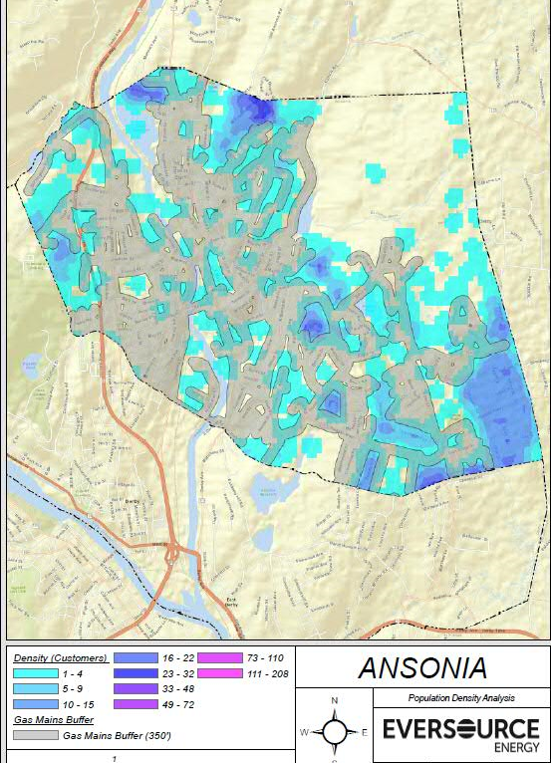
Identifying Project Locations
Locate areas unserved within close proximity to current natural gas system
Are there system efficiencies to gain by connecting segments of the distribution system?
Is the ratio of density to size of the homes adequate?
How does the location synch up with the municipal paving program or other utility work?
Do we have all of the components necessary to offer residents a no cost gas service?

Slide 7
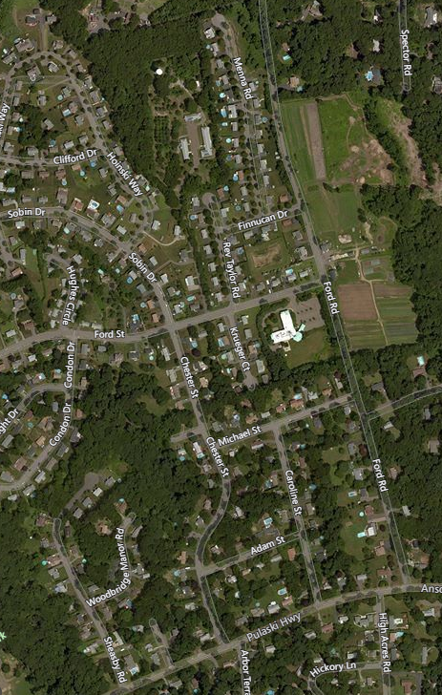
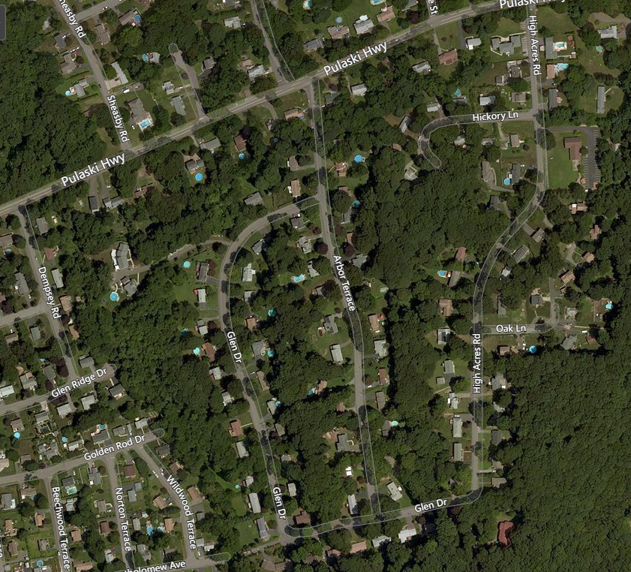
Ansonia Residential Expansion
Project Route 22,475’ or 4.25 miles
$2.9M Investment
172 Meters Over 3 Years
$1M NFMCs
Access to gas for over 294 residential properties
Construction began August 30, 2016 utilizing 3 contractor crews and was completed November 17, 2016
59 gas services have been installed
Existing 4” PL IP Main
Existing 4” ST IP Main

Slide 8
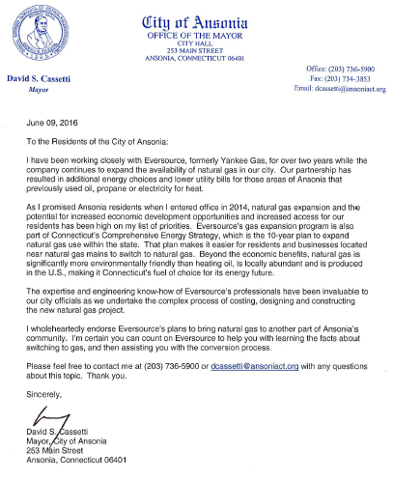
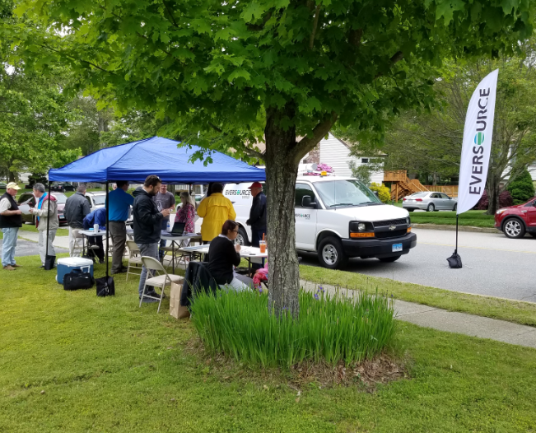
Residential Expansion Communications

Slide 9
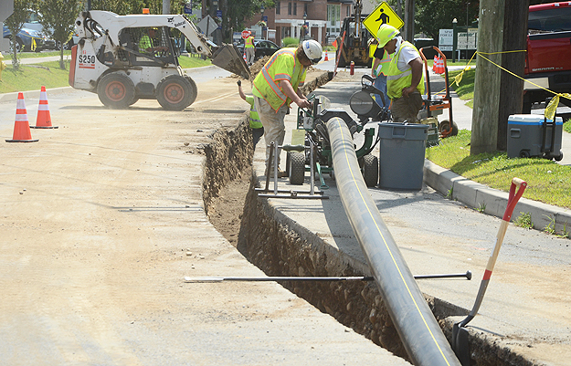
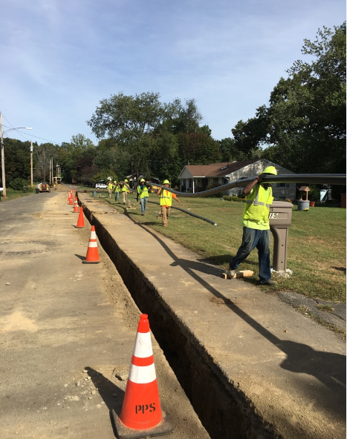
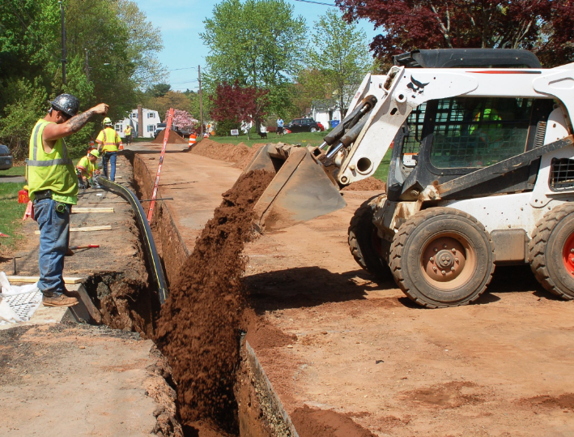
Project Photos

Slide 10
Questions & Answers
Panel

