Slide 1
CPES Meeting Cromwell, CT
Mike Dirrane
U.S. Marketing, Enbridge
June 14, 2017

Slide 2
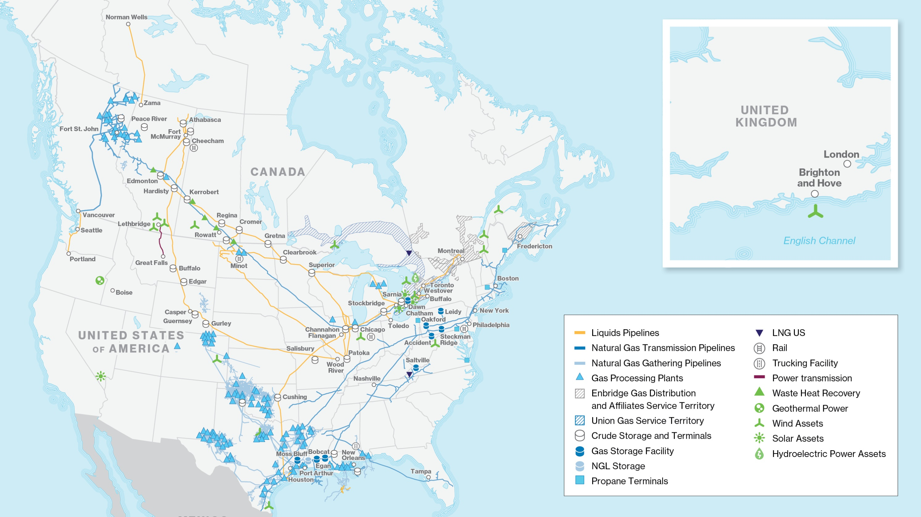
SLIDE
2

Slide 3
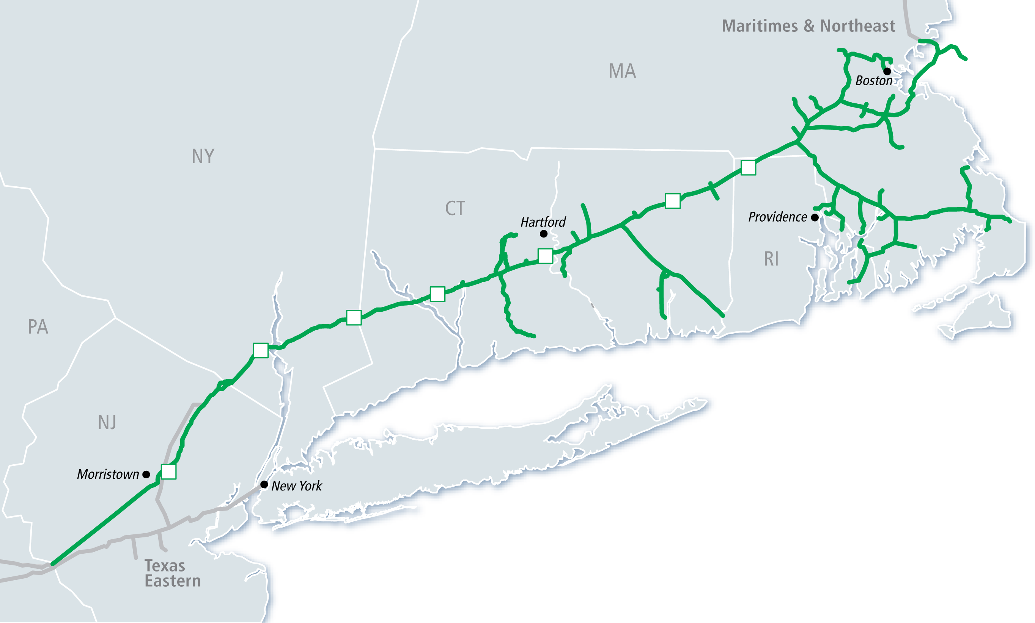
Algonquin Gas Transmission

Slide 4
Boston Daily Average EHDD

Slide 5
Monthly Deliveries
Algonquin Gas Transmission

Slide 6
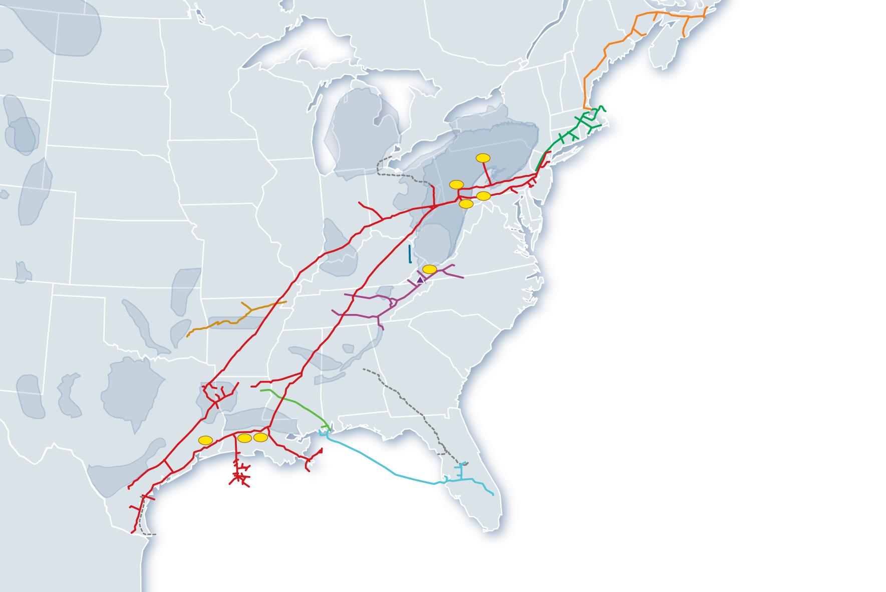
Growth Now and in the Future
Northeast & New England
Strong throughput throughout winter seasons
Market expansion opportunities to serve LDCs, power generators and industrial customers
Power Generation
Supply to Markets
Demand Market Growth
Marcellus/Utica
Marcellus averaging 5.5 Bcf/d of flows directly into Texas Eastern
By 2017, Spectra Energy will have capacity for transport of ~9.5 Bcf/d out of the basin
LNG &
Mexico Exports
Southeast & Gulf Coast
Significant incremental growth from power generation coal conversions
Gulf Coast regional demand projected to increase 19 Bcf/d by 2025
Power Generation
Notes:
Impact of High Contractor Bids:
Forecast contract commitments exceed estimate by $59 MM.
Impact of delayed clearances from Agencies and FERC Certificate:
Anticipated delayed NTP for Contractors.
Additional costs for construction inspection staff due to delays.
Impact of permitting conditions:
Additional requirements for site specific construction techniques.
Use of composite crews to comply with permit conditions.
Impact of Stakeholder issues / concerns:
Mitigation payments to various stakeholders to maintain schedule.
Management of protester interference (permanent and temporary security measures).
Additional legal fees.

Slide 7
Texas Eastern Appalachian Shale Supply Growth

Slide 8
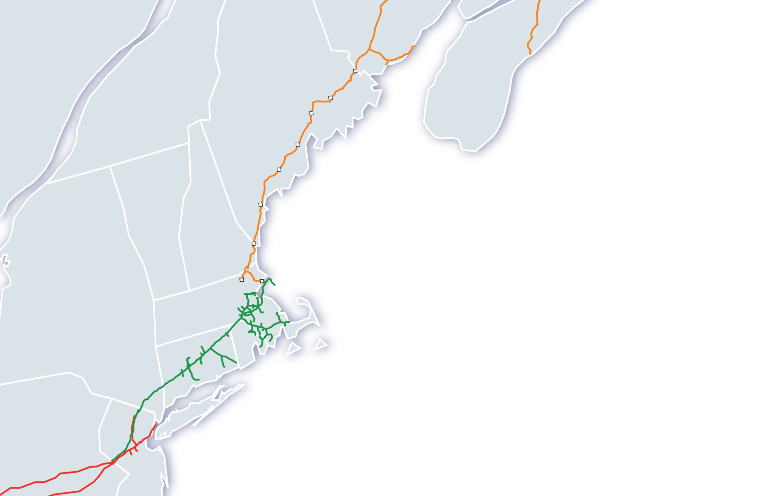
New England Market Driven Projects
ME
Strong throughput throughout winter seasons
Market expansion opportunities to move abundant, economic supplies of natural gas from the Marcellus & Utica plays to serve LDCs, power generators and industrial customers
Maritimes & Northeast
NS
QC
MA
VT
Project Status
AIM – Full in-service January 2017
Salem Lateral – In-service November 2016
Atlantic Bridge – Received FERC Certificate January 2017; expecting partial in-service November 2017, with full in-service in 2018
NH
NY
Salem Lateral
MA
CT
RI
Regional Supplies
Algonquin
Project | Volume (MMcf/d) | Target In-service
AIM | 342 | In-Service
Salem Lateral | 115 | In-Service
Atlantic Bridge | 133 | 4Q17, 2018
PA
Texas Eastern
NJ
Notes:
Impact of High Contractor Bids:
Forecast contract commitments exceed estimate by $59 MM.
Impact of delayed clearances from Agencies and FERC Certificate:
Anticipated delayed NTP for Contractors.
Additional costs for construction inspection staff due to delays.
Impact of permitting conditions:
Additional requirements for site specific construction techniques.
Use of composite crews to comply with permit conditions.
Impact of Stakeholder issues / concerns:
Mitigation payments to various stakeholders to maintain schedule.
Management of protester interference (permanent and temporary security measures).
Additional legal fees.

Slide 9
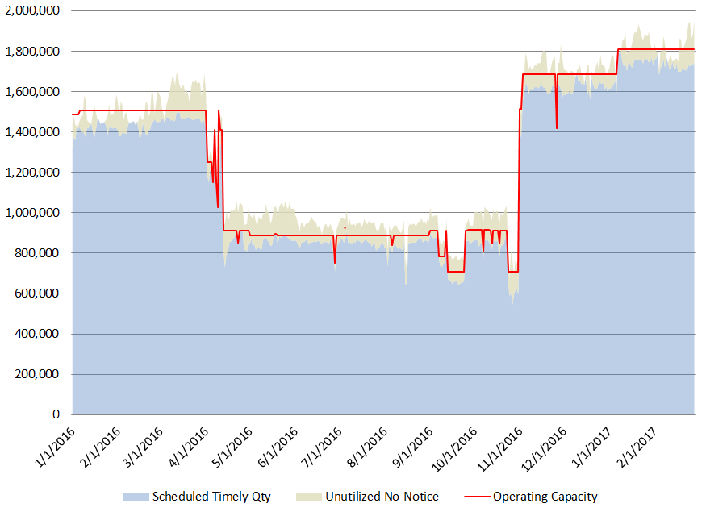
AIM Scheduling Impacts AIM Capacity Fully Utilized Daily
9

Slide 10
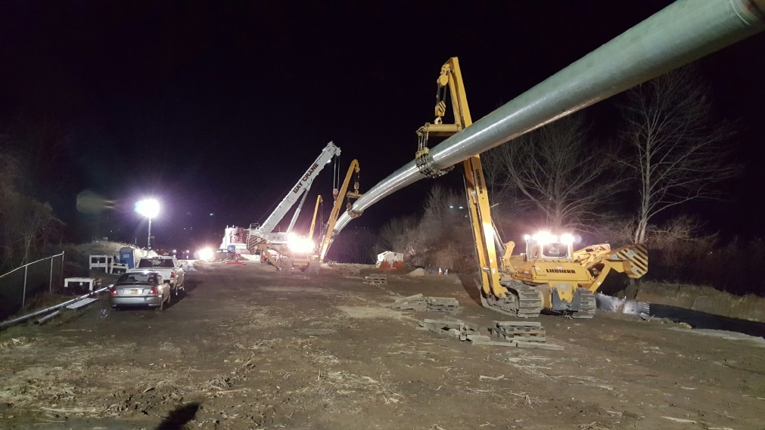
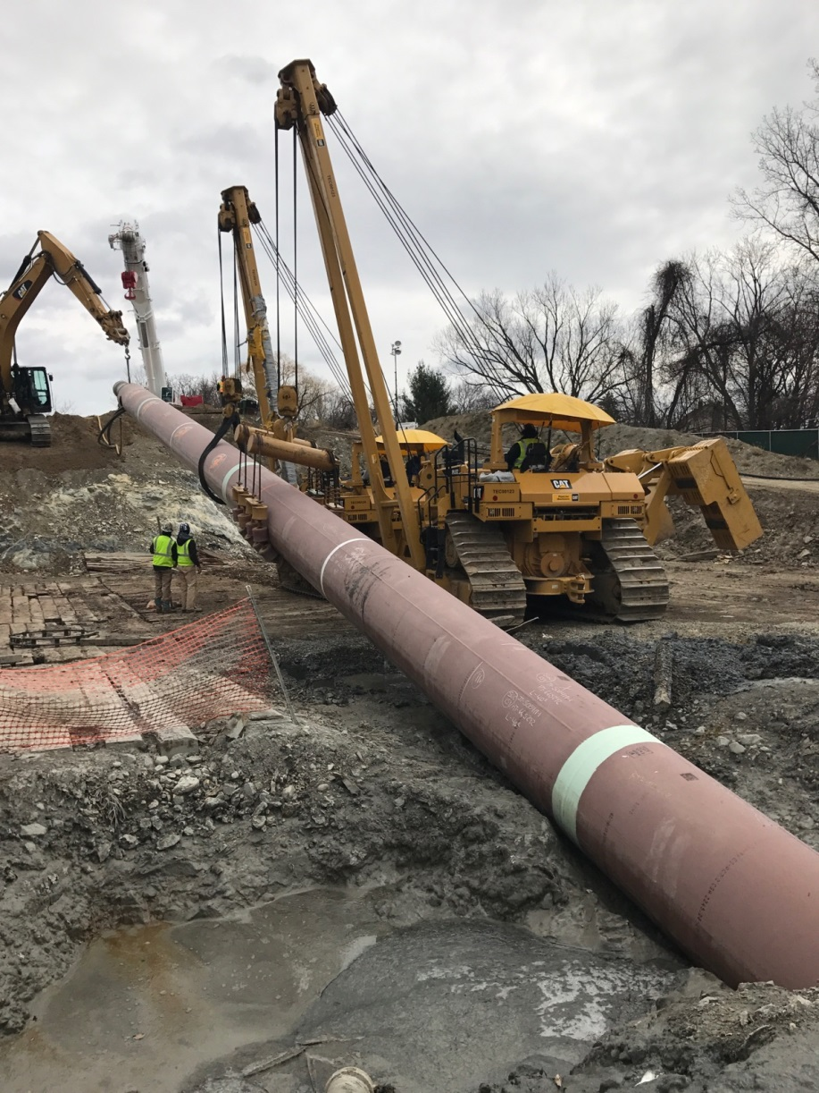
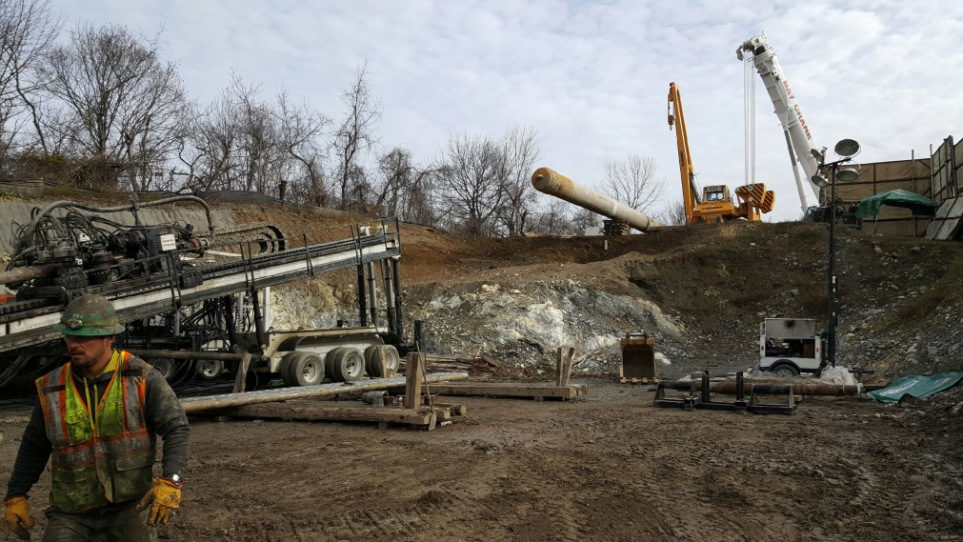
AIM Project Successful Execution in New England

Slide 11
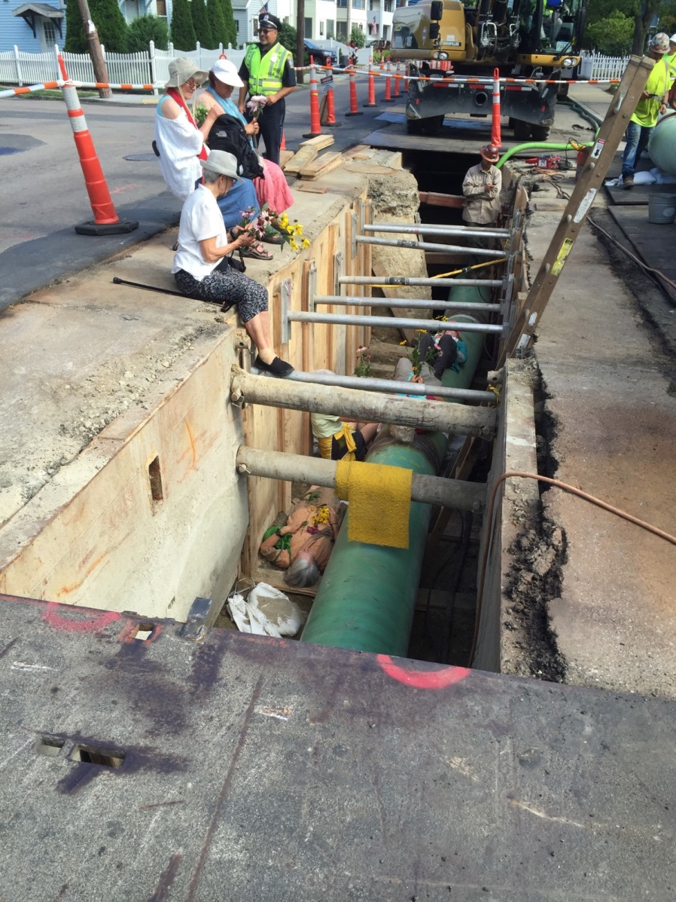
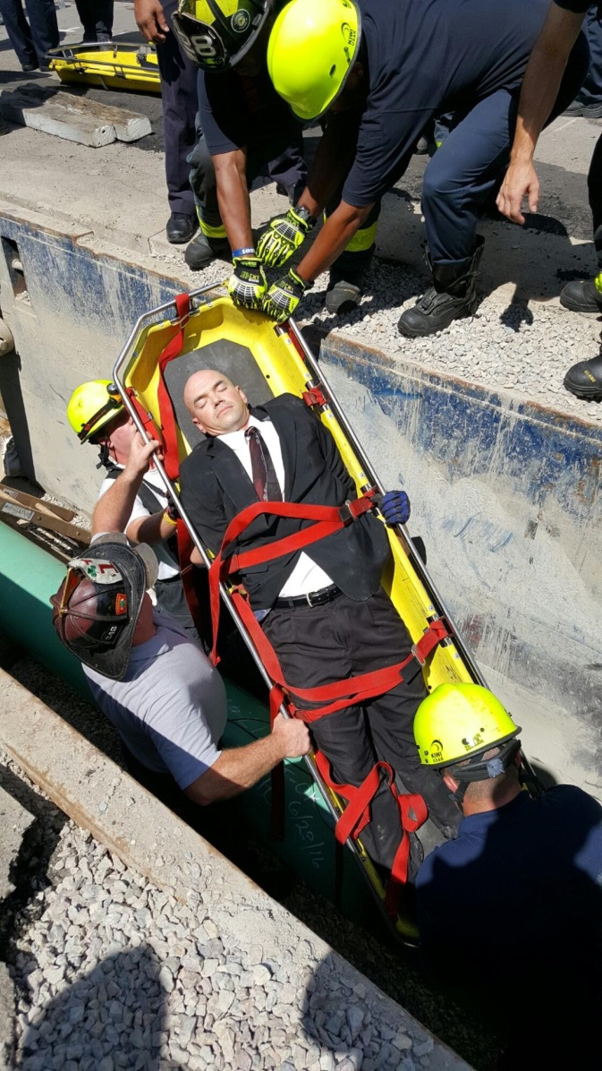
AIM Project Successful Execution in New England

