Slide 1
CNG & SCG CPES Natural Gas Infrastructure Project Updates
June 14, 2017

Slide 2
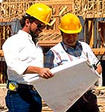
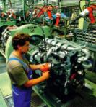
Connecticut Gas Growth: The Benefits of Natural Gas
Job Creation
Economic Impact
Customer Savings
Business Competitiveness
Energy Independence
Environmental Benefits
CPES June 14, 2017

Slide 3
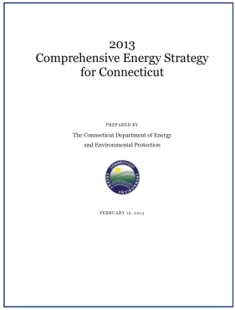
Connecticut Gas Growth: The Comprehensive Energy Strategy
CES Overview
2013 Legislative mandate Public Act 11-80
From transportation to renewables
Cleaner, cheaper, more reliable energy for CT
Major component is Natural Gas expansion
CES Gas Tools
Changes to the Hurdle Rate Model
System Expansion Rates
Portfolio Projects
Use of Non-Firm Margin (NFM)
CPES June 14, 2017

Slide 4
Connecticut Gas Expansion: Sales Strategy
Education & Outreach
Pro-active sales team
B2B direct sales
Door to door campaigns
Dedicated NEP teams
Competitive targeted sales blitz’s
Consultative sales, NGV, DG, Micro-grid etc.
Town Hall meetings
Association meetings
Targeted incentives
Contractor Network
Layer Incentives – manufacturer, rebate, CLM
Leveraging financing partners & state program (i.e. CPACE)
Robust CRM Tool – Salesforce.com
Heat Economically
Heat Sustainably
Heat Reliably
CPES June 14, 2017

Slide 5
Connecticut Gas Expansion: Marketing Strategy
Direct Mail, Radio, Web, Print Advertising & Animated videos
Consistent & repetitive campaigns “Heat Smart”
Theme messaging: Clean, Convenient, Affordable, Reliable etc.
Targeted, phased expansion marketing
New homeowner & real estate transactions
On & near main prospects
Construction & paving notifications
Low use conversions
Manufacturer incentives
CPES June 14, 2017

Slide 6
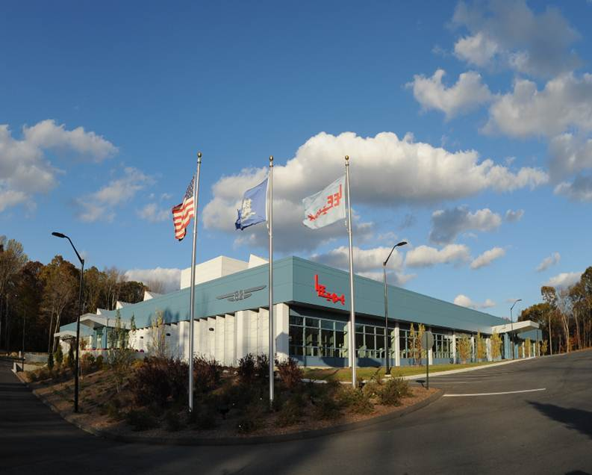
Connecticut Gas Expansion: 2014 New Franchise for SCG - Essex
Essex 5 miles in 60 days
Project:
5.5 miles
$2.75 million capital spend
Anchor Customers:
The Lee Company
Essex Elementary School
Essex Meadows
Essex Industrial Park
Providing Energy Choice:
90 commercial businesses
140 residential homes
Norm Needleman, First Selectman: “We believe the expansion of natural gas service into Essex will make the town more competitive, helping us attract new businesses and giving existing businesses greater flexibility in their energy choices. It will also provide another fuel option for the residents of the area served by the new natural gas main, potentially helping them to lower their energy costs and reduce their impact on the environment.”
CPES June 14, 2017

Slide 7
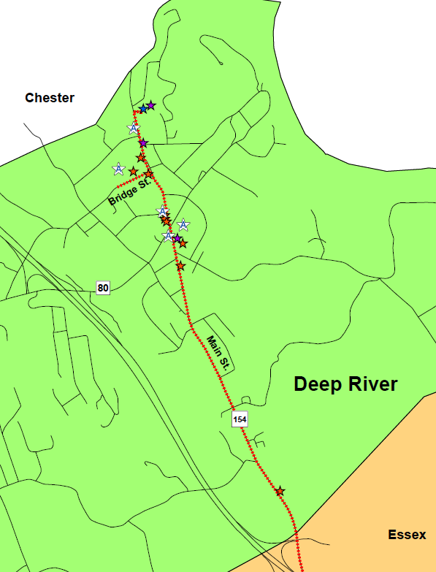
Connecticut Gas Expansion: 2015 New Franchise for SCG – Deep River
SCG makes gas available to the Town of Deep River
Project:
4 miles of new gas main
$3 million capital spend
Challenge:
CIAC - $250,000
Anchor Customers:
Silgan Plastics - manufacturer
Deep River Town Hall & Library
Deep River Elementary School
Kirtland Commons
Dick Smith, First Selectman: “The benefits to our Town are more far-reaching than the direct savings to customers alone. Confirming our focus on maintaining and expanding infrastructure, our inventory of utilities has grown, embellishing our reputation as business-friendly. As the commercial / industrial sector expands, our tax base will strengthen, and our economy will grow.”
CPES June 14, 2017

Slide 8
Connecticut Gas Expansion: 2015 New Franchise for CNG – East Hampton
A true partnership between CNG and East Hampton
Company Commitment
14 miles of new gas main – first new franchise for CNG
$6 million capital spend
Providing fuel choice to over 500 residential & commercial prospects
Municipal Commitment
Convert all town buildings and all schools to natural gas – 9 buildings
CIAC of $500,000
Town responsible for paving and road restoration
Town to provide all easements and expedited permitting
CPES June 14, 2017

Slide 9
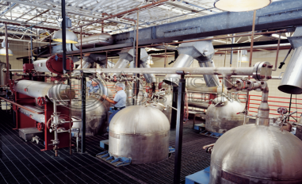
Connecticut Gas Expansion: 2015 New Franchise – East Hampton
Making Business More Competitive
American Distilling - World’s largest supplier of witch hazel
Major employer and tax payer in East Hampton
Significant industrial heating requirements
Clean burning natural gas supports their eco friendly mantra:
“Lean, Mean and Green from Day One”
CPES June 14, 2017

Slide 10
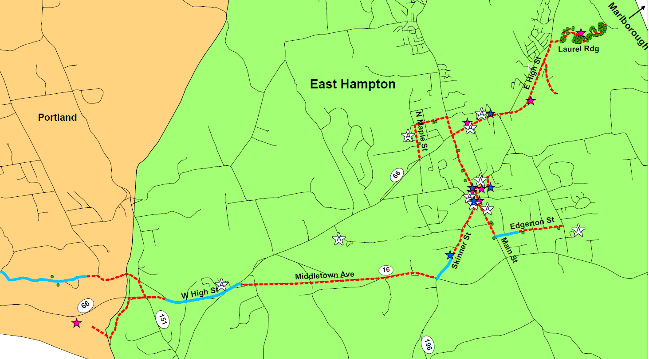
Connecticut Gas Expansion: 2015 New Franchise – East Hampton
Mike Maniscalco, Town Manager: “This project creates a major savings opportunity for the town. Residential and commercial property owners who have been paying big heating bills are excited about the chance for another energy option, and the Town is excited about enhancing infrastructure and diversifying our tax base.
CPES June 14, 2017

Slide 11
Connecticut Gas Expansion: 2014 TO 2016 Results
Metric | 2014 - 2016
New Customers | 34,510
New Miles of Main | 153
Dth | 6,981,759
Comprehensive Energy Strategy
Provide energy choice to thousands of businesses and households
Expand CT natural gas infrastructure
Lower energy costs for residents and businesses
Help reduce carbon emissions
Increase CT’s energy resiliency
We continue to add thousands of new customers each year.
CPES June 14, 2017

Slide 12
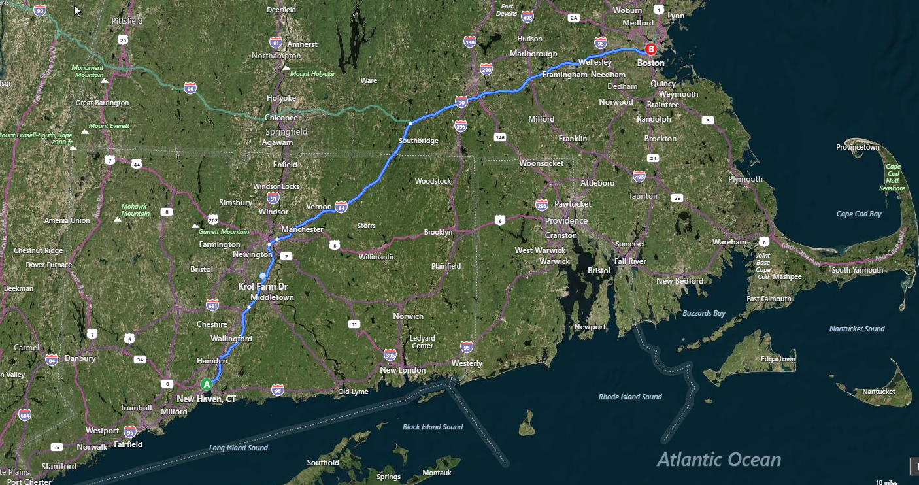
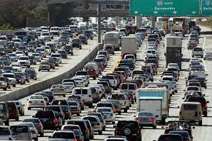
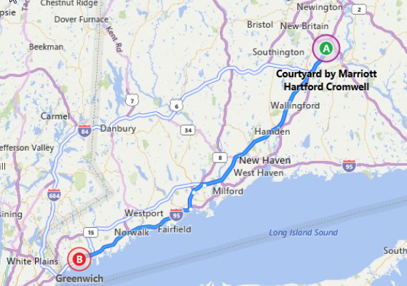
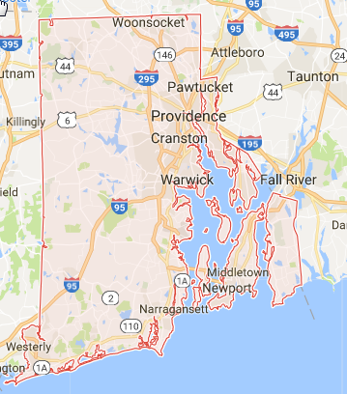
Connecticut Gas Expansion: Results In Perspective
2014: The Commute
From Cromwell to Bridgeport
48 Miles
153 Miles
in 3 years!
2015: Hartford to Greenwich
68 Miles
Targeting over 180 Miles by YE 2017
37 Miles
2016: The width
of Rhode Island
37 Miles
CPES June 14, 2017

Slide 13
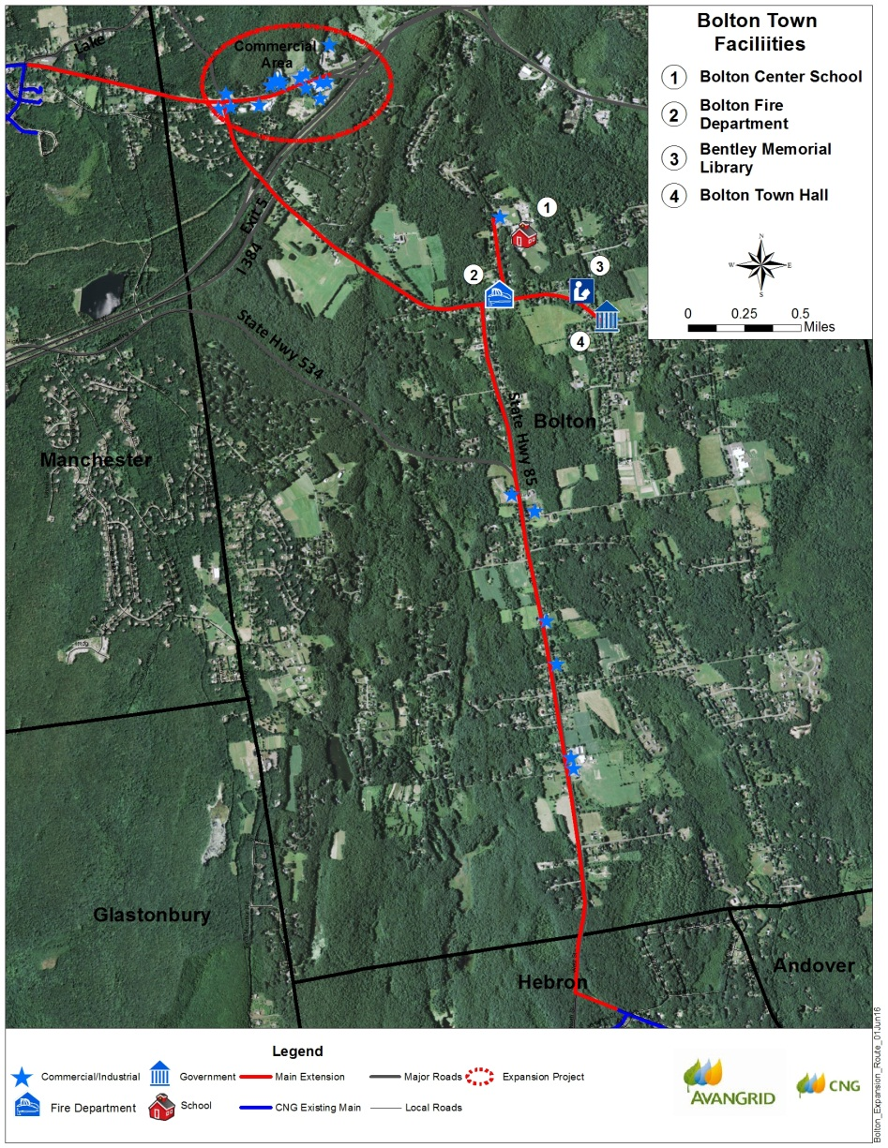
Connecticut Gas Expansion: 2017 New CNG Franchise to Bolton, CT
Project
7 Miles
Capital Spend $ 4.5 Million
NFM Allocation $ 340,000
Challenge
CIAC $ 216,000
Anchor Customers:
Simoniz Headquarters
Center School
Fire Department
Library
Town Hall
CPES June 14, 2017

Slide 14
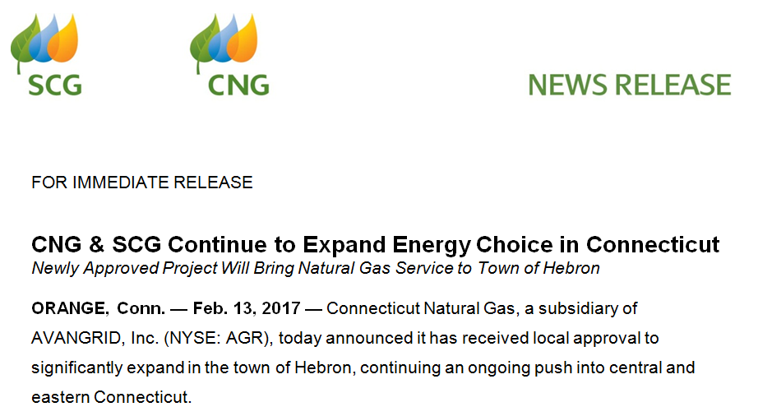
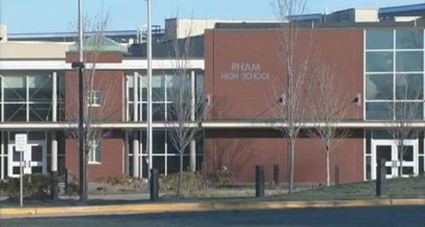
Connecticut Gas Expansion: 2017 Major CNG Gas Expansion to Hebron
Project:
8.1 Miles
Capital Spend $ 5.6 Million
NFM Allocation $ 2.1 Million
Challenges:
CIAC $ 758,800
Largest CIAC secured
Anchor Customers:
RHAM High School
RHAM Middle School
Town Offices
Two Elementary Schools
Fire Department
Village Green Development
CPES June 14, 2017

Slide 15
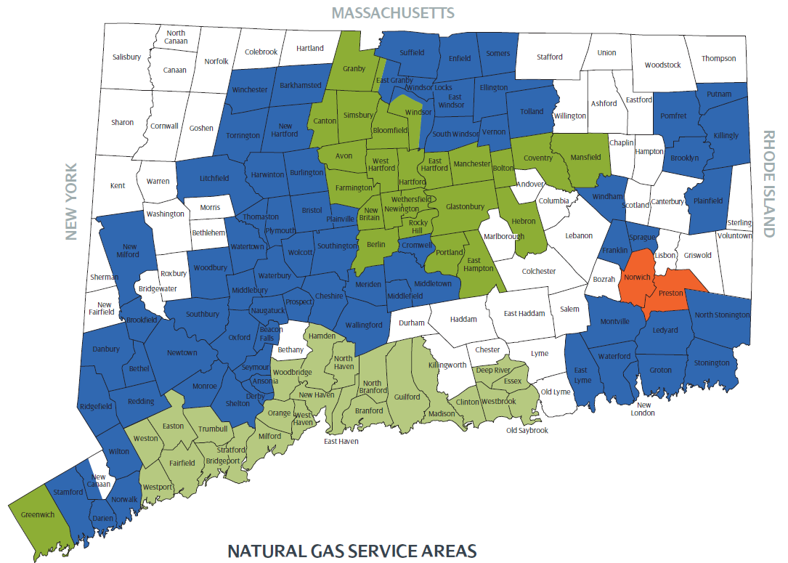
Connecticut Gas Expansion: The Results
Coventry
Coventry
Bolton
Bolton
Andover
Hebron
Hebron
Marlborough
East
Hampton
East
Hampton
Bethany
Chester
Killingworth
Deep
River
Deep
River
Essex
Essex
Major Exp.
Greenwich
CPES June 14, 2017

