Slide 1

Some final thoughts…
This is a very serious process with substantial safety and environmental concerns, as with other serious processes in our society.
The technology is continuing to evolve dramatically…
Over 20% of the wells installed in PA are not yet producing…
Yet no one has yet successfully overestimated the actual production of the Marcellus.
Gas production could double in PA even if no new well pads were built.

Slide 2
Some final thoughts…
The collection, transmission and distribution infrastructure is limiting…
The E&P portion of the industry is very diverse, with individual firms having very different business models.
Industry will be getting much more aggressive in public relations outside of production communities in 2014.
Future discussions of environmental metrics will be driven towards impacts per btu produced. May well be some big surprises here…

Slide 3
``
Some final thoughts…
The environmental, economic, and national security benefits of having this energy source are astounding.
This technology has been funded 100% by private sector innovators, encouraged by current tax policies.
The challenges are substantial, and the opportunities are breathtaking…

Slide 4
Some final thoughts…
THANKS!

Slide 5
Natural Gas Resource Development
February 19, 2014

Slide 6
THANK YOU
Shale Gas 101

Slide 7
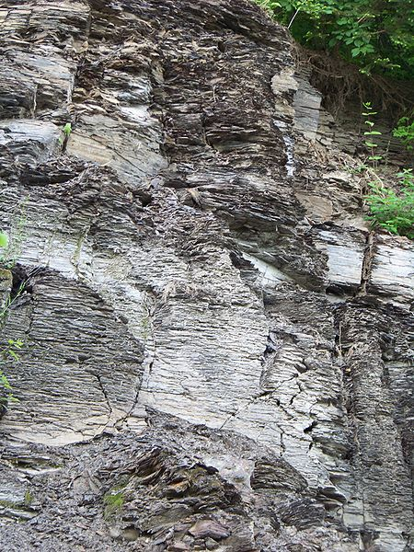
Marcellus Shale: Introduction
What is the Marcellus Shale?
- Geological formation formed by accumulation of sediment into a sea almost 400 million years ago
- Compressed to produce an organic-rich black shale.
- Starts at NY, Catskills, stretches across toward Marcellus, New York then southwest to PA, West Virginia, Kentucky, and Ohio.
Why Now?
- Success of other shale plays has allowed companies to transfer horizontal drilling and technology to other areas.
- Proximity to high-demand markets along the East Coast make it an attractive target for energy development.
Marcellus Shale bank along Route 174 just
south of Slate Hill Rd in Marcellus, NY

Slide 8
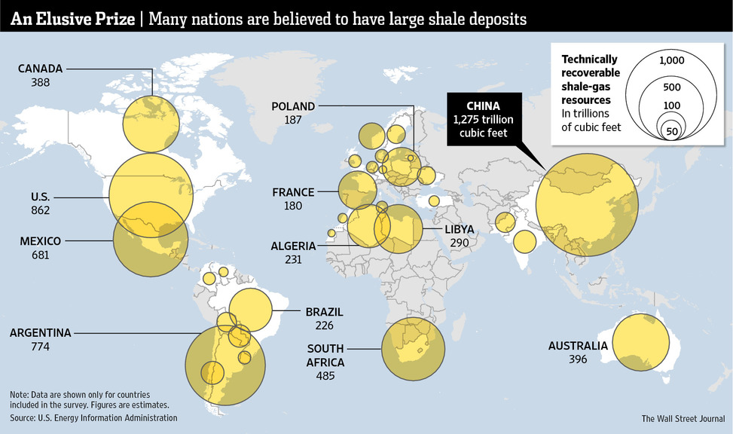
Shale Gas – Global Opportunity
North America
1,931 trillion cubic feet

Slide 9
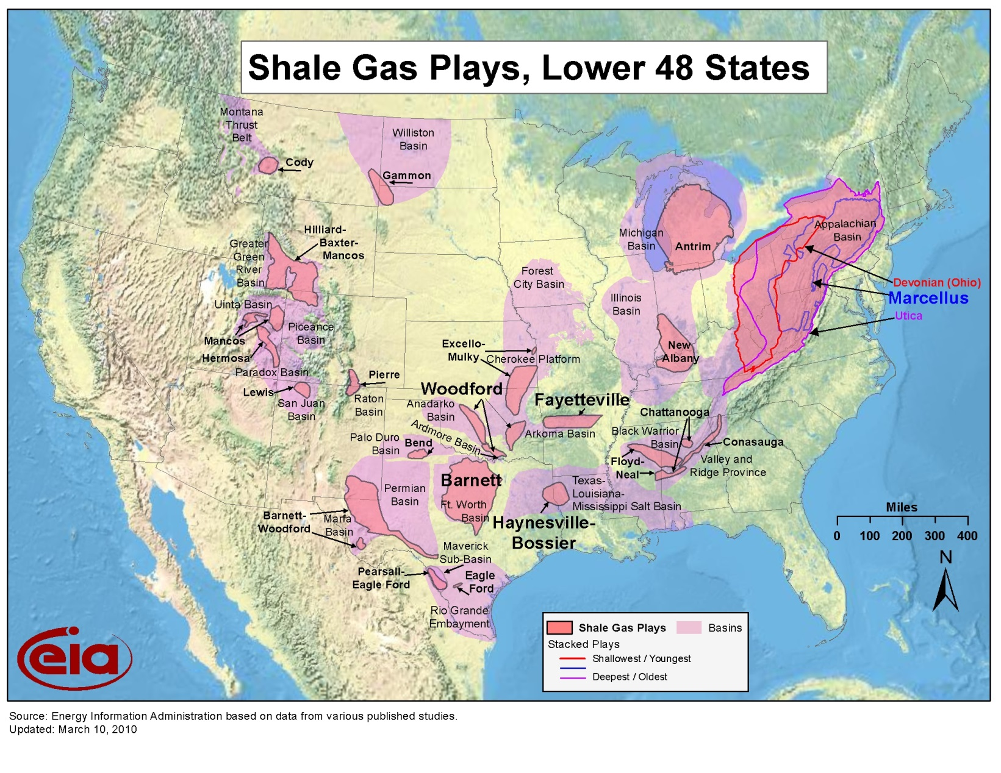
Shale Gas Revolution Across the U.S.
Source: Energy Information Administration

Slide 10
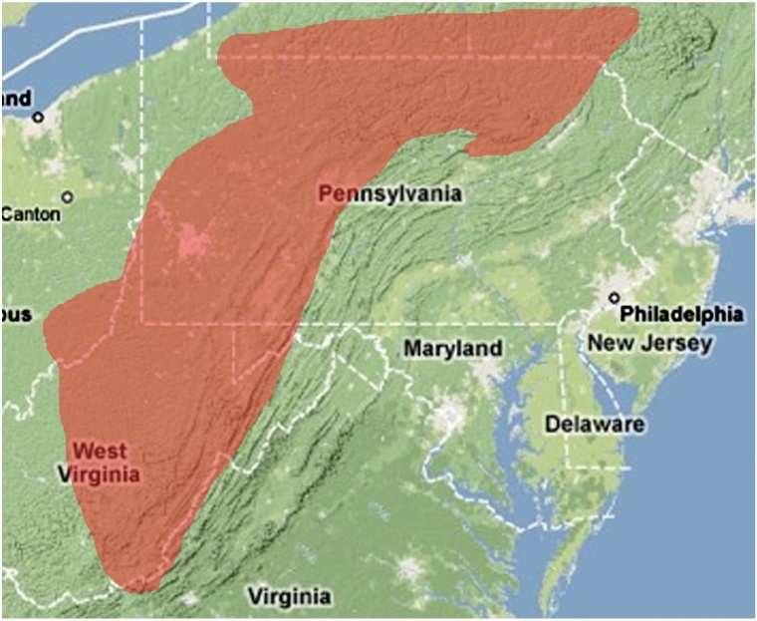
Marcellus Shale: Geographic Footprint
Notes:
first successful U.S. oil well drilled in 1859 in pa
Since then hundreds of thousands gas/oil drilled and frac’ed

Slide 11
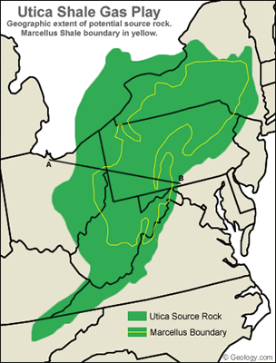
Utica Shale
Below the Marcellus
Bigger, deeper, denser
One of the latest U.S. unconventional energy fields
Particularly attractive in OH
Success in the Marcellus has led to success in the Utica

Slide 12
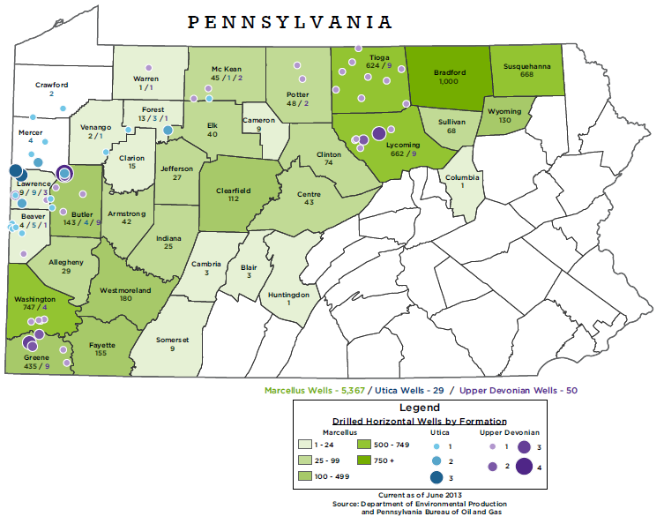
PA Well Count

Slide 13
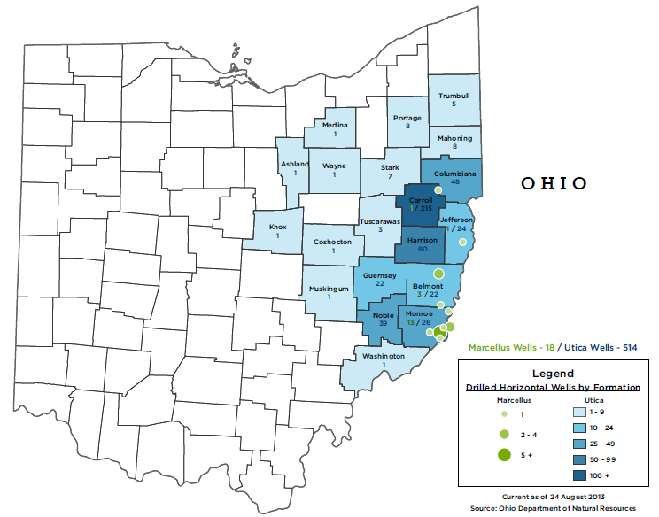
OH Well Count

Slide 14
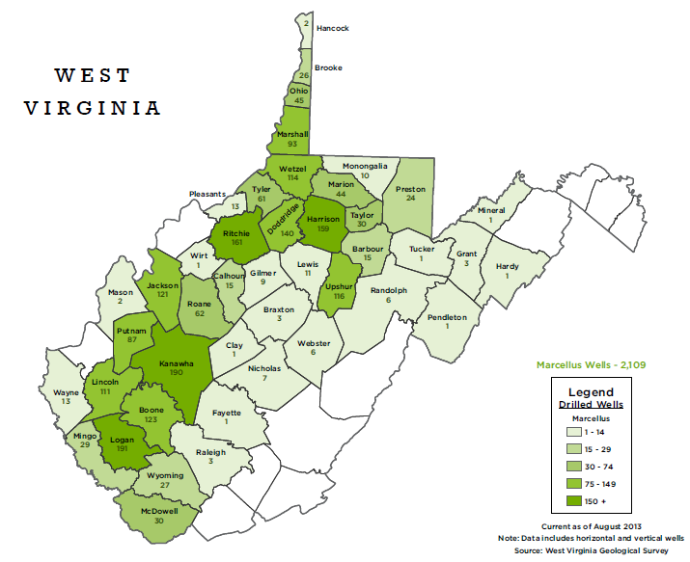
WV Well Count

Slide 15
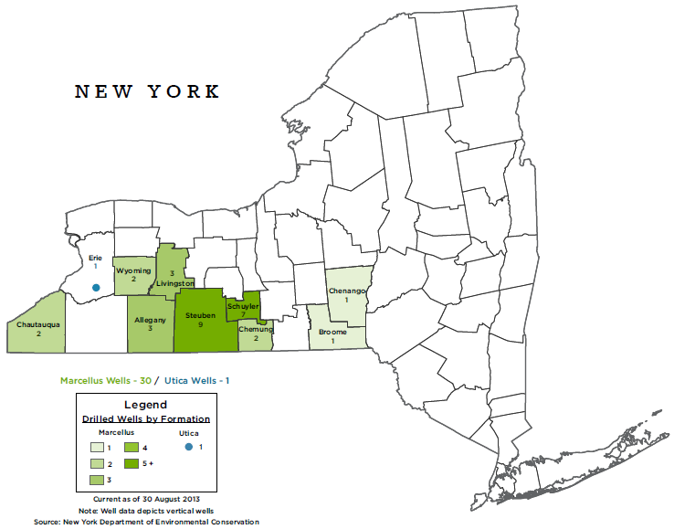
NY Well Count

Slide 16



Industry Segments
UPSTREAM
MIDSTREAM
DOWNSTREAM
Exploration and Production
Gas Field Exploration
Well Drilling and Hydraulic Fracturing
Gas Recovery and Production
Gathering and
Gas Processing
Gas Collection and Transportation Systems (Gathering Pipelines)
Gas Processing (Dehy, Separation, Fractionation)
Compression (Well Head, Gathering)
Selling and
Distribution
Interstate and LDC Transportation Systems (Transmission and Distribution Pipelines
Compression (Transmission)
Regulation
Metering
Notes:
Bringing nat gas to the surface
Storing and transporting nat gas
Selling and distributing nat gas

Slide 17
Segments of the Oil and Gas Industry
Exploration and Production (Upstream)
Home Heating/Cooking
Gathering, Compression, Treating, Processing, Transportation (Midstream)
Electric Power
Petrochemical and Refining (Downstream)
Industrial Boilers/Furnaces
Gathering Pipelines
Gas Treating, Processing and Fractionation
Natural Gas
(Methane)
Interstate Gas
Pipelines
LNG (Liquefied and shipped)
Gas
CNG (Fleet Fuel, Buses, etc)
Compression
Oil, Gas, Water
Separation
Propane
Home Heating, Cooking
Transportation, Industrial fuel
Water
Oil
Natural
Gasoline
Ethane
Well
Butanes
Glad Baggies
Water
Injection
Well
Plastics
Propane
Petrochemical
Plants
Styrofoam
Alcohols
Interstate Oil
Pipelines
Propane,
Butanes,
Gasoline's
Other Chemicals
Unleaded Gasoline
Oil and/or Gas Reservoir
5,000- 16,000 ft deep
Oil Refineries
Diesel
Jet Fuel
Asphalt
Other
Source: MarkWest Energy Partners

Slide 18
Exploration/Production, Midstream, and Downstream 101

Slide 19
Steps in Drilling
Land Acquisition/Site Preparation
Obtain rights from landowner.
Educated landowner is an ideal partner.
“Production unit” - contiguous parcels of land combined for development.
Production unit incorporated into a company’s drilling program.
Site is prepared for drilling activity.
Notes:
Prior to the drilling of a natural gas well, companies must first obtain the rights to develop the mineral resources from a landowner.
An educated landowner, one who seeks expert guidance prior to leasing their mineral rights for development, is an ideal partner.
After the mineral rights are leased, companies then create a “production unit,” where they pull contiguous parcels of land for development.
Once a production unit is created, it is then incorporated into a company’s drilling program and at predetermined time, the site is prepared for exploration.

Slide 20
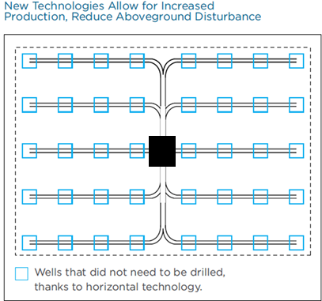
Steps in Drilling
Horizontal Drilling
More efficient production, smaller footprint.
Conductor, surface casing protect drinking water source.
Well is drilled vertically and horizontally as much as 5,000 feet.
Wellbore is approximately 20 inches in diameter at its widest.
5 ac vs. 24 ac = 1 acre when done

Slide 21
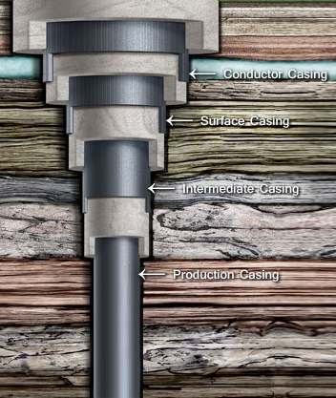
Environmental Protection in Wells
Well Casing
Multiple layers of steel and cement to ensure redundant protection
  1 – through fresh water aquifer
  2 – to depths of ~1,500 feet
  3 – to final depths
Cementing to surface at each layer provides stability and protection, preventing the crossflow of hydrocarbons
25 PA Code, Chapter 78 rules have further strengthened standards
Notes:
100 ft = well
1000 ft = municipal sources
8-10k ft = shale

Slide 22
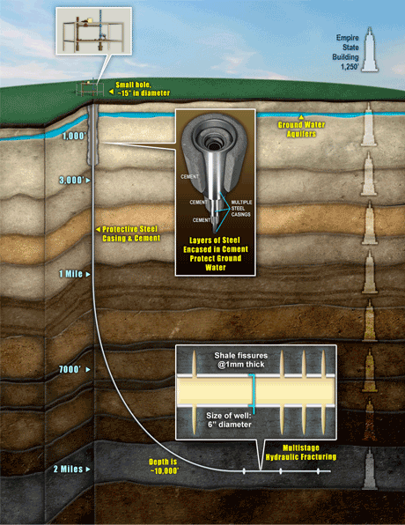
Steps in Completion
Hydraulic Fracturing
Permits from state regulatory agencies for water withdrawal.
New technologies allow producers to recycle most water
30 State and federal agencies monitor hydraulic fracturing
Industrial process; properly encased well, along with proper containment at the surface is critical.

Slide 23
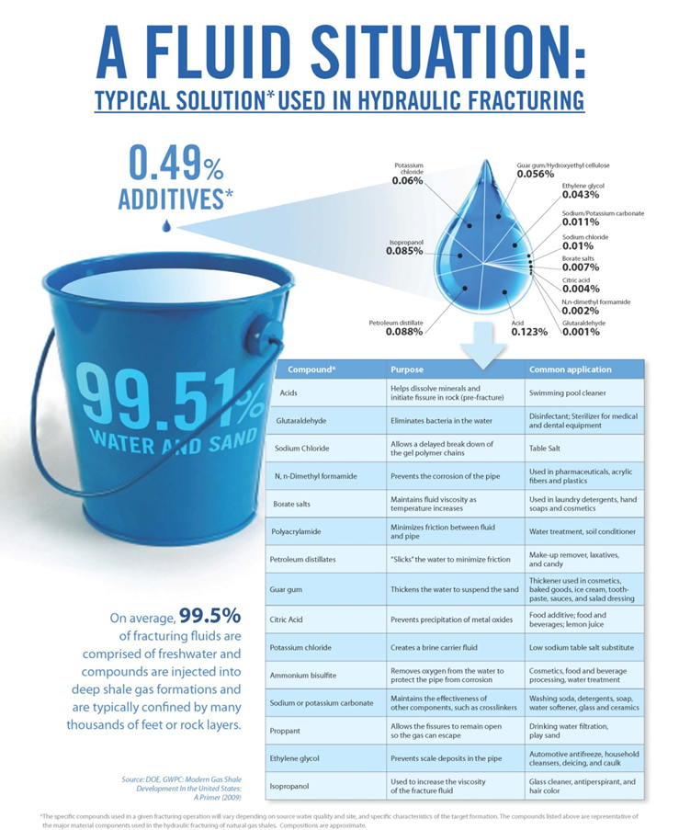
Steps in Completion
Hydraulic Fracturing (HF)
> 60 years: more than 1 million wells in 27 states
90 percent of oil and gas wells use HF technology
99.5 percent water/sand mix
3 to 5 million gallons of water fractures the shale.
Well casing protects water supply
PA Chapter 78 upgrades reflect best practices in well casing

Slide 24
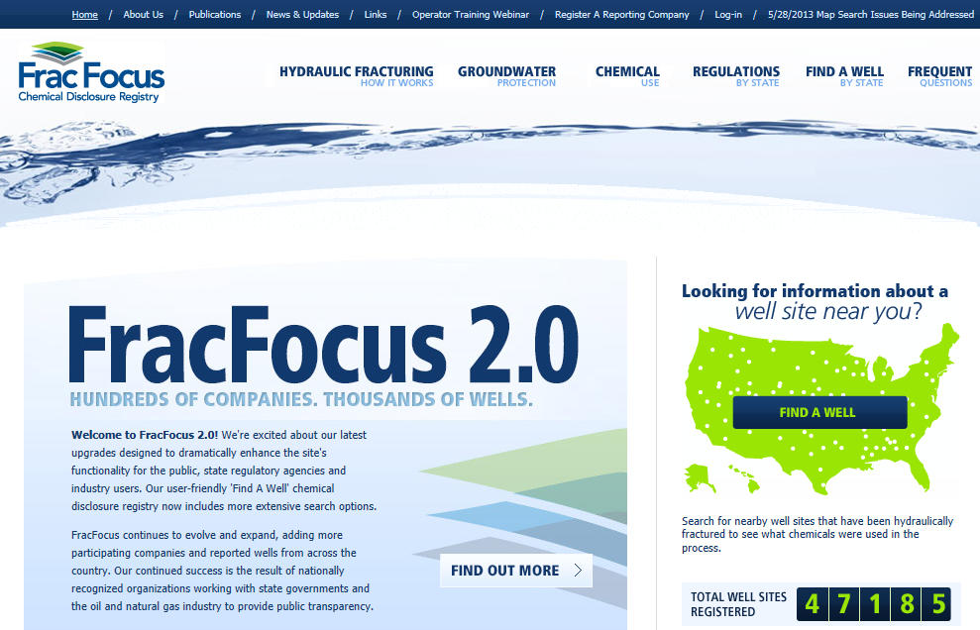
Transparency in Completion
MSC Commitment to FracFocus.org Bolsters PA Requirements
FracFocus.org is a Project of the Groundwater Protection Council and the Interstate Oil & Gas Compact Commission

Slide 25
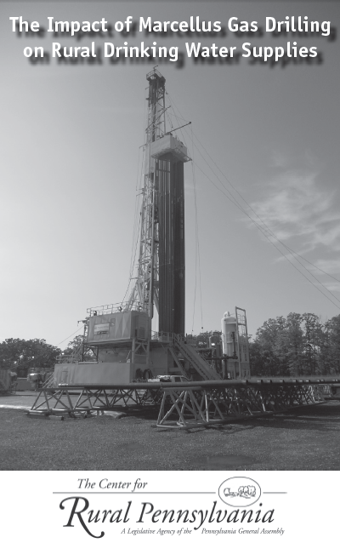
Environmental Protection
Center for Rural PA Study
Comprehensive research over two years, published in 2011
Suggested private water well standards are needed
Pre-drill testing by natural gas companies – a public service
Regulations require testing of all water supplies within 2,500’ of proposed gas well.
>40% of 1.2 million private water wells do not meet safe drinking water standard, separate from industry activity
Another 20% percent of wells contained pre-existing methane

Slide 26
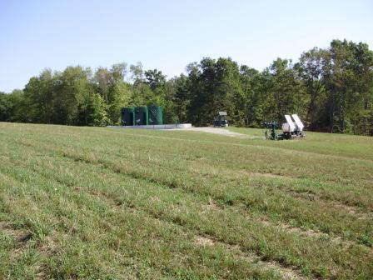
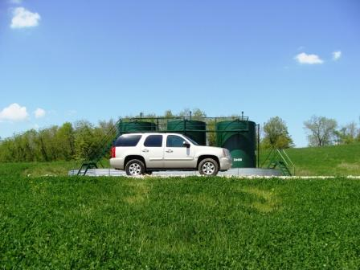
Steps in Production
Site Restoration
Involves landscaping and contouring the property as closely as possible to pre-drilling conditions.
Property owners generally see:
  Small wellheads on a level pad
  Small amount of equipment
  Two to three water storage tanks
  Metering system to monitor gas production
Courtesy: Range Resources

Slide 27
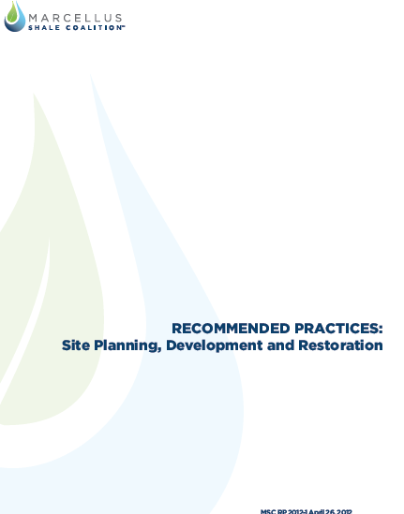
Recommended Practices
Developed in collaboration with:
PA Federation of Sportsmen’s Clubs
Ducks Unlimited
National Wild Turkey Federation
Wildlife for Everyone Foundation
The Nature Conservancy
Ruffed Grouse Society
Western PA Conservancy
PA Outdoor Writers Association
American Chestnut Foundation

Slide 28
Focus on Midstream
Gathering Line defined in PA state law as a pipeline used to transport natural gas from a production facility to a transmission line
  Along the way, the lines can lead to a compressor station and possibly a processing plant (in wet gas areas)
Location of pipelines are subject to negotiation between property owner and pipeline company
Right of Way Agreements between property owner and pipeline company recorded with county
Right of Way can contain multiple pipelines and can range from 50-75 feet in width
  Additional width for construction
Source: MarkWest Energy Partners

Slide 29
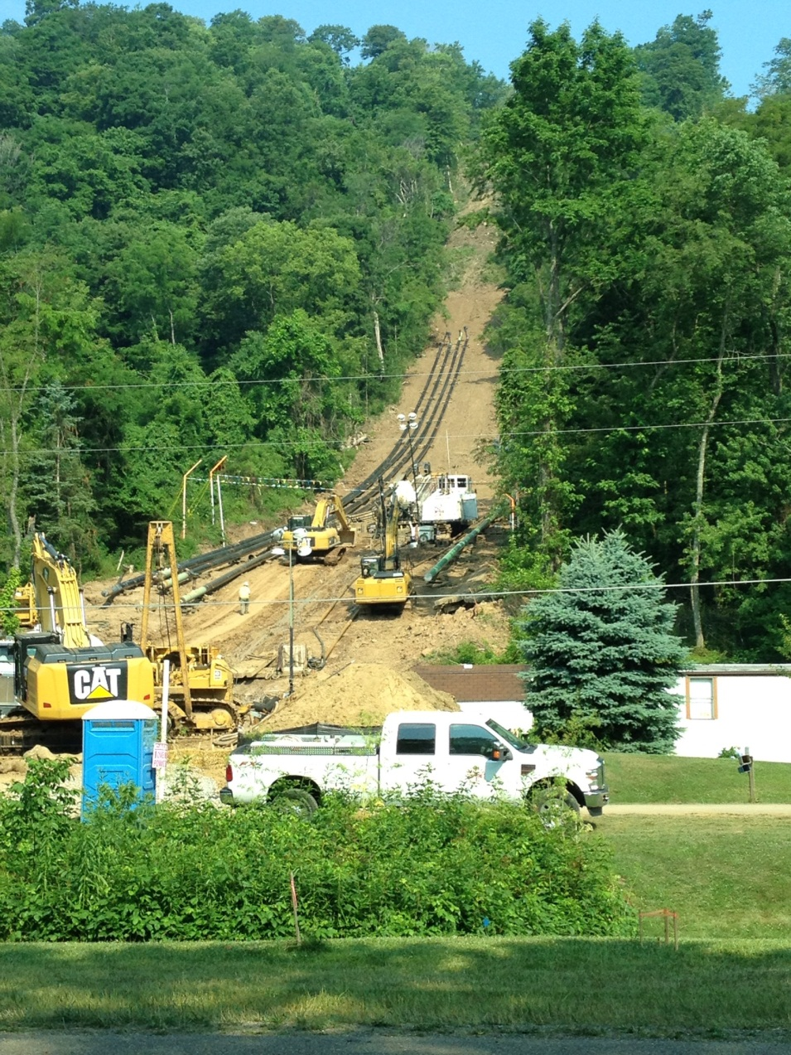
Focus on Midstream
Gathering and Transmission Pipelines
Critical link between production and consumers
Pipelines can transport gas before or after processing
Designed and constructed to the latest pipeline safety standards
Utilize new construction methods to minimize the environmental impact
New coating technologies mean pipelines will last even longer
Geographic Information Systems allow for efficient layout and accurate tracking of pipeline systems
Subject to regulatory inspection (PAPUC, DOT PHMSA)

Slide 30
Pipeline Safety
Pipelines are considered the safest mode of transportation for natural gas and hazardous liquids
  Does not mean that other modes are not safe
  State and federal regulation of pipelines and safety
Federal Pipeline Safety, Regulatory Certainty, and Job Creation Act of 2011
  Pennsylvania Gas and Hazardous Liquids Pipelines Act of 2011
  Pennsylvania Underground Utility Line Protection Law (PA One Call Law)
  Pennsylvania Act 13 of 2012
Third party damage is the greatest threat to pipeline safety
  Pipeline Placement report recommendation for mandatory One Call participation

Slide 31
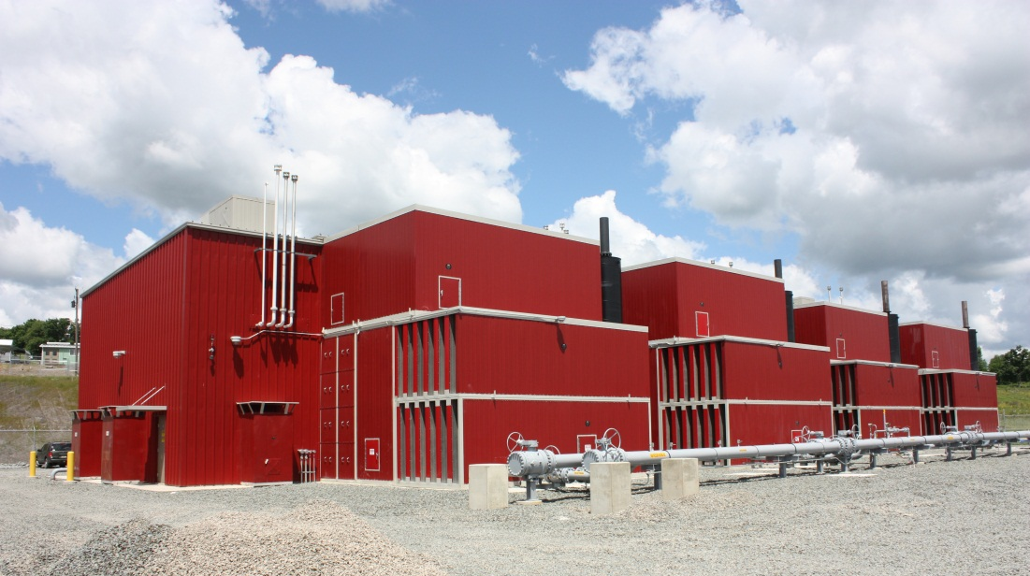
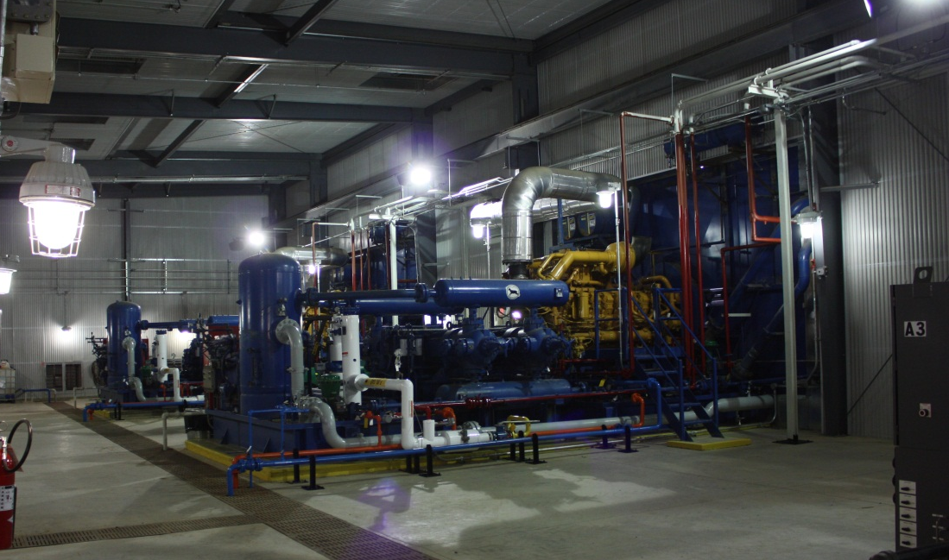
Compression Systems
Compressor Stations
State of the art sound attenuation
Built to the highest welding, fabrication, and material standards
24/7 monitoring and control
Automatic safety systems
Annual inspections by regulating entities
Compressor Packages
High tech integrated control systems (engine and compressor)
24/7 monitoring and control
Produced and packaged in the USA
Operated and maintained by local workers

Slide 32
Marcellus Shale Coalition
THANK YOU

Slide 33
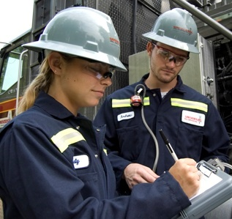
Marcellus Shale Coalition
About Us
  Approximately 300 members strong
  From producers to midstream to suppliers
Our Focus
  Long-term development of resource
  Protecting the environment and responsible use of water resources
  Addressing landowner, government and public issues
  Benefits to our region’s future

Slide 34












Environmental Protection
Highly regulated. Highly sophisticated.
Transparency in permitting
Staffing, permit fee increases
Advances in water recycling and reuse
Protective well casing standards
Focus on best practices
FracFocus.org
Notes:
Improved predictability/transparency of permitting
Staffing increases with substantial permit fee increases
Major technical advances in water recycling and reuse
Even more protective well casing standards, including additional venues for chemical disclosure
Continued best practice sharing between industry and regulators

Slide 35

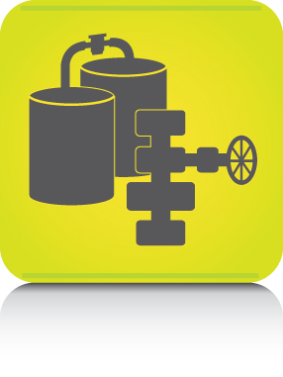




Regulatory Framework
Site Construction
Reclaimed/Completed Site
12 PA Regulations
10 PA Regulations
Drilling Phase
Midstream
Hydraulic Fracturing
18 PA Regulations
11 PA Regulations
18 PA Regulations

Slide 36
Environmental Regulation – Midstream
Various environmental permits and clearances may be required for the construction of pipelines
  Erosion and Sediment Control Permits under the PA Clean Streams Law
  Stream Crossing Permits under the PA Dam Safety and Encroachments Act
  PA Natural Diversity Inventory clearances to protect threatened and endangered species
  PA State Programmatic General Permits (PA DEP- US Army Corps of Engineers) under the Federal Clean Water Act
Other midstream facilities, such as compressor stations and processing plants, require multitude of permits and clearances

Slide 37
Environmental Protection
Source: CONSOL Energy

Slide 38
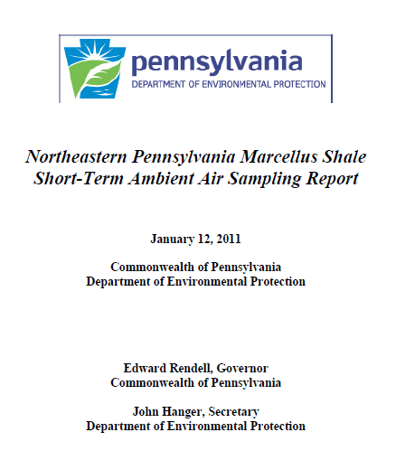
Environmental Protection
Air Quality Standards
  Short-term monitoring in Northeastern, Southwestern, and North Central PA:
    “[D]id not identify concentrations of any compound that would likely trigger air-related health issues associated with Marcellus Shale drilling activities.”
Air quality standards tightly-regulated:
  Gas Processing Plants: Plan approval/air permit
  Compressors: Covered by GP-5
Companies exploring “bifuel” rigs to reduce use of diesel

Slide 39
Environmental Protection
Environmental, Public Health Benefits of Natural Gas
When used to generate electricity, natural gas emits just over half of the CO₂ per megawatt-hour (MWh) of a traditional power plant.
Natural gas combined-cycle turbines emit 60 percent less CO₂ per MWh than a typical coal plant.
Natural gas vehicles emit 25% less CO₂ than vehicles that run on traditional fuels.
According to the Congressional Research Service, if U.S. doubled the utilization of combined cycle natural gas capacity to 85%, we could displace approximately 636 million metric tons of CO₂. This amounts to an 8.8% reduction of all CO₂ emissions in the U.S.
Notes:
PA Department of Environmental Protection (DEP) reports conducted in NE and SW PA.
Gas Processing Plants
Plan approval/air permit
Compressors
Covered by GP-5
Fugitive emissions
Roads
Compressor stations
Flares
Temporary sources
Source Aggregation
White paper

Slide 40

PA Jobs, PA Workers
PA Department of Labor and Industry
  231,969 employees in Marcellus and related industries as of 2013 Q1*
  Core industries were 35.0% higher in 2013 Q2 than in 2010 Q2*
  Core Industry occupations
    Crude Petroleum & Natural Gas Extraction ($110,119)
    Natural Gas Liquefied Extraction ($100,841)
    Drilling Oil and Gas Wells ($84,862)
    Support Activities of O&G Operations ($70,401)
    O&G Pipeline & Related Structures ($82,127)
    Pipeline Transportation of Natural Gas ($85,747)
  $83,300 average core industry wage ($34,800 higher than PA avg.)*
*Source: Marcellus Shale Fast Facts, September 2013, PA Department of Labor and Industry

Slide 41
PA Jobs, PA Workers
PA Department of Labor and Industry
  Ancillary Industries
    Non residential site preparation contractors ($53,191)
    Trucking (general freight, specialized freight) ($42,582-$51,771)
    Commercial & industrial machine and equipment repair ($54,323)
    Water Supply, Sewage treatment facilities, and infrastructure construction ($45,560-$66,741)
    Engineering Services ($79,147)
  $65,000 average ancillary industry wage ($16,500 higher than PA avg.)*
*Source: Marcellus Shale Fast Facts, September 2013, PA Department of Labor and Industry

Slide 42

Statewide Job Opportunities
Department of Labor and Industry: 3,730 Marcellus job postings statewide
Most found at MSC job portal
Support for ShaleNET
Training network responds to market demands

Slide 43
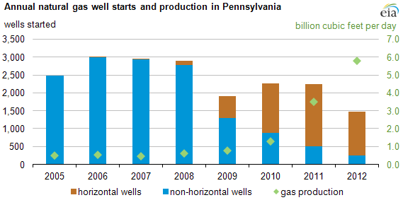
Increases in Production

Slide 44
Economic Impact for Our Region
More than 4,500 wells drilled between 2010 and 2012, an investment of approximately $31.5 billion
2013 projection: $13.5 billion
  Leasing and bonuses
  Exploration
  Drilling and completion
  Pipelines and processing
  Royalties
Source: Survey of Marcellus Shale Coalition Board Member Companies

Slide 45
Revenue for Pennsylvania
Paid by Natural Gas Industry
Overall taxes since 2006¹ | > $1.8 billion
Road construction investments since 2008² | > $700 million
Royalty payments to state in 2011³ | $177 million
Permitting and enforcement fees to increase DEP personnel since 2009 ⁴ | $40.5 million
Impact Fee in first two years ⁵ | > $400 million
¹ – Fox News, July 23, 2013
² – On-going Survey of Marcellus Shale Coalition Members
³ – Pennsylvania Department of Conservation and Natural Resources, 2013
⁴ – Pennsylvania Department of Environmental Protection, 2013
⁵ – Pennsylvania Public Utility Commission (2007-2011 grandfathered wells plus 2012 assessment)

Slide 46
Impact Fee Revenue Allocations

Slide 47
Revenue to Local Government
Excludes Housing Affordability and Rehabilitation Fund

Slide 48
Impact Fee Top 10 Earning Counties

Slide 49
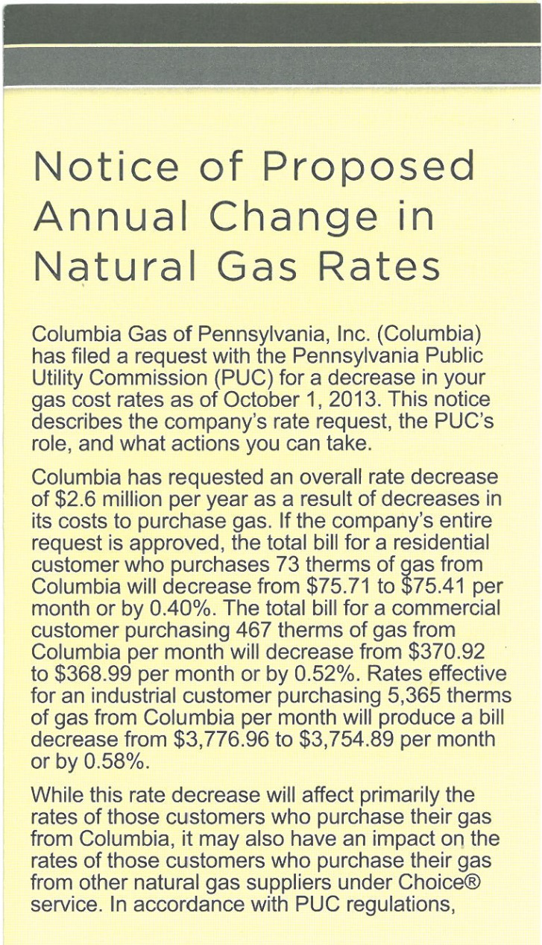
Savings for Consumers
Heating
  EIA: Family of four in an 1,800 sq. ft. home can save about $1,500 a year, or 60%, by switching to gas.
Electricity
Natural gas vehicles
Consumer products
Source: Philadelphia Inquirer, May 19, 2013

Slide 50
Natural Gas Job Phase
Pre-drilling (Exploration)
Geologic studies, permitting, water management, engineering/design, site preparation, environmental and safety compliance
Drilling (Extraction)
Pipeline, compressor, well facilities construction, Hydraulic Fracturing & completions, water management, environmental and safety compliance
Production/Reclamation
Engineering, site reclamation, environmental and safety compliance
Delivery to Market
(transport, storage, marketing)
  NG Marketers, commodity traders, logistics, storage, accounting, risk management

Slide 51
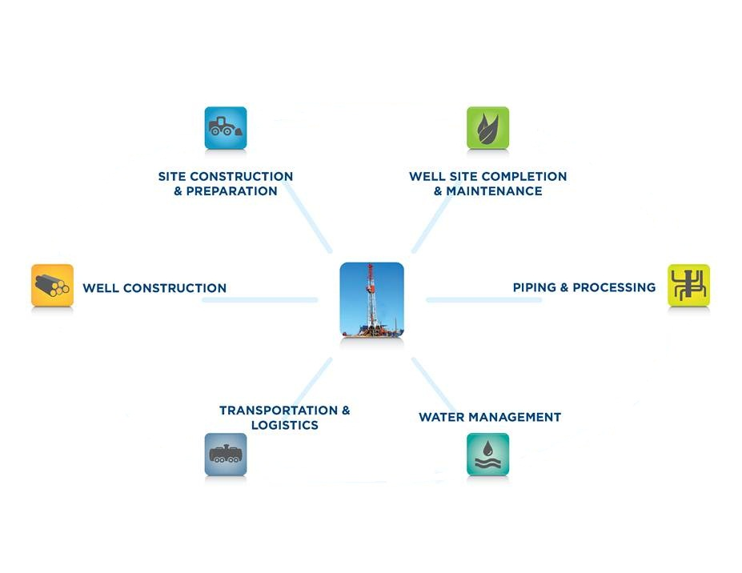
Marcellus Multiplier
Fast Facts $7+ million investment to produce each well 400+ individuals within nearly 150 different occupations needed to complete and produce gas from a Marcellus well (MSETC, 2010)

Slide 52
Know the Law
Act 13, §2316 – Small business participation
Producers shall provide maximum practicable contracting opportunities for diverse small businesses, including minority, women and veteran-owned businesses.
Producers shall do the following:
  Maintain a policy prohibiting discrimination in employment and contracting based on gender, race, creed or color
  Use the Department of General Services’ Internet database to identify certified diverse small businesses
  Respond to a survey conducted by the Department of General Services
  Survey shall be sent to all producers within one year to report the producers’ efforts to provide maximum practicable contracting opportunities related to unconventional natural gas extraction for diverse, small business participation

Slide 53
THANK YOU
The Economics of Shale Gas

Slide 54
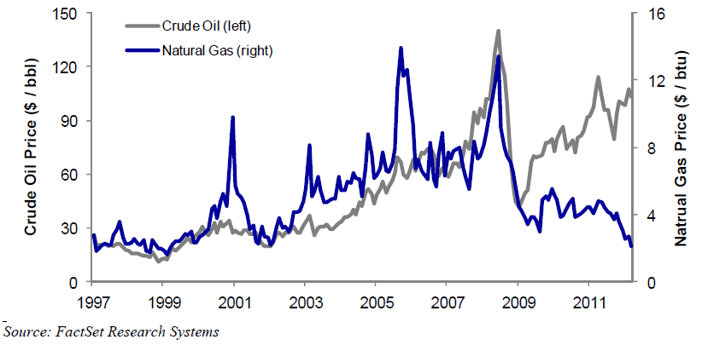
“Decoupling” of Oil and Gas Prices

Slide 55
Clean, Abundant, and Versatile
Electricity generation, heating
Combined heat and power applications
Light and heavy duty transportation applications
Feedstock for industries and other liquids use
Exports

Slide 56
Energy Consumption Overview

Slide 57
Clean, Abundant, and Versatile
Electricity generation, heating
Combined heat and power applications
Light and heavy duty transportation applications
Feedstock for industries and other liquids use
Exports
57 | MARCELLUS SHALE COALITION

Slide 58
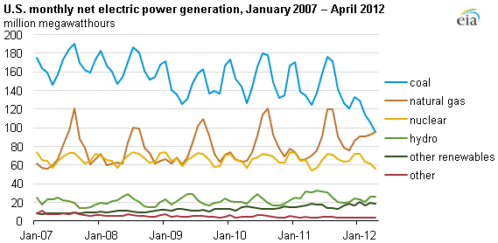
U.S. Power Generation
Monthly coal- and natural gas-fired generation
equal for first time in April 2012

Slide 59
Clean, Abundant, and Versatile
Electricity generation, heating
Combined heat and power applications
Light and heavy duty transportation applications
Feedstock for industries and liquids use
Exports

Slide 60
Pennsylvania CHP Summary
Source | Sites | Capacity (kW)
Total | 135 | 3,276,430
Boiler/Steam Turbine | 54 | 1,929,075
Combined Cycle | 5 | 1,156,400
Combustion Turbine | 10 | 97,715
Fuel Cell | 3 | 580
Microturbine | 14 | 4,290
Other | 1 | 231
Reciprocating Engine | 47 | 85,139
Waste Heat Recovery | 1 | 3,000
Source: ICF International, 2011

Slide 61
Clean, Abundant, and Versatile
Electricity generation, heating
Combined heat and power applications
Light and heavy duty transportation applications
Feedstock for industries and other liquids use
Exports

Slide 62
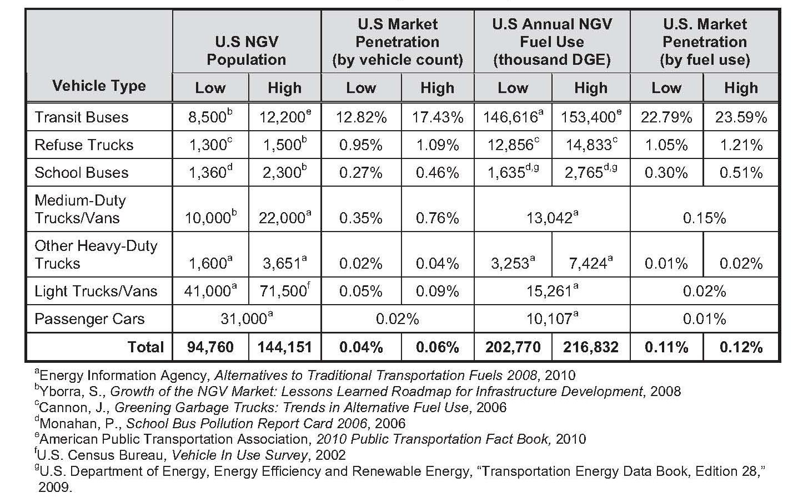
NGV Market Penetration

Slide 63
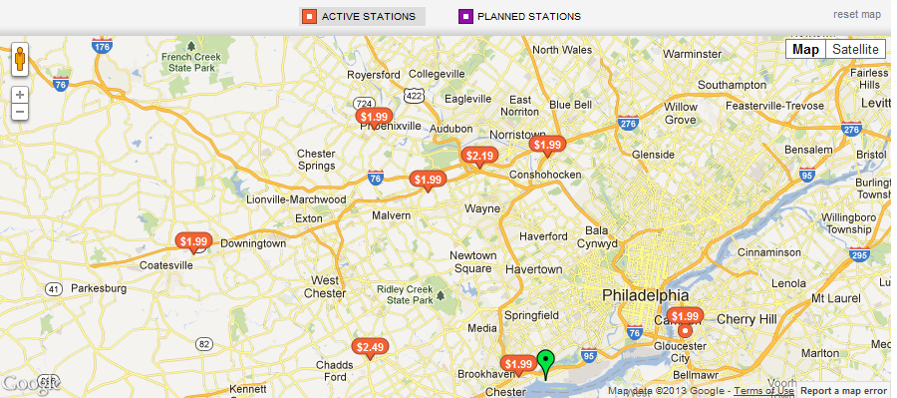
SEPA Natural Gas Equivalency Prices

Slide 64
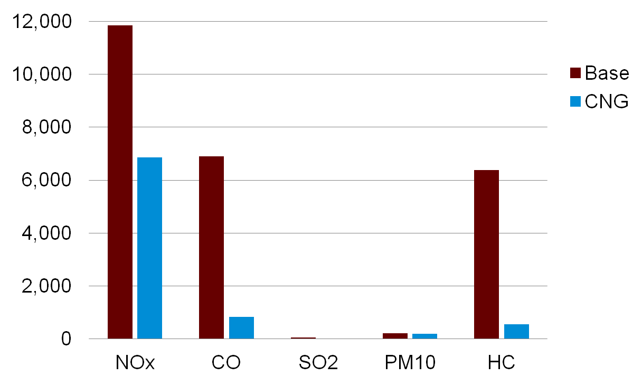
Neighborhood Air Emissions
Neighborhood Air Emissions
Base Case (Diesel) vs. CNG Case
42% Reduction
lbs/year
88% Reduction
91% Reduction

Slide 65
Clean, Abundant, and Versatile
Electricity generation, heating
Combined heat and power applications
Light and heavy duty transportation applications
Feedstock for industries and other liquids use
Exports

Slide 66
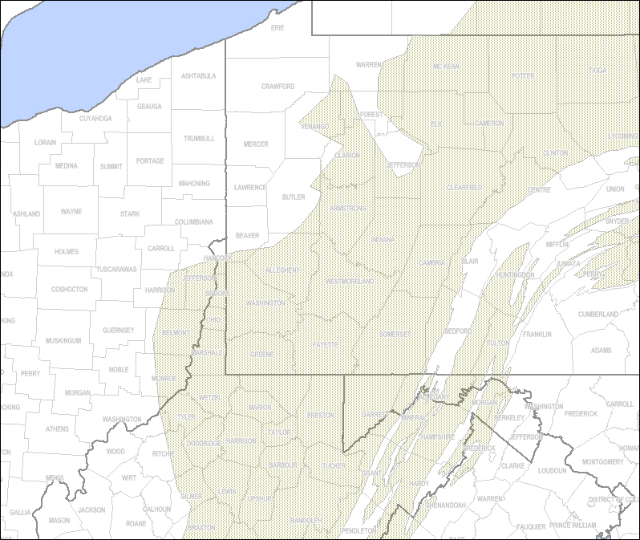
“Wet Gas” Region
Wet Gas
1200+ Btu per Mcf
Dry Gas
<1200 Btu per Mcf
Legend
Marcellus Shale Formation
Wet Gas Region
Sources: Pace Global; Equitable Resources, MarkWest, Atlas Energy, Range Resources, and Caiman Energy.

Slide 67
Composition in Wet Gas Region
Source: Pace Global; NiSource Gas Transmission and Storage Presentation to WVONGA Spring Meeting May 6, 2010 p.5
Notes:
Source: NiSource Gas Transmission and Storage Presentation to WVONGA Spring Meeting May 6, 2010 p.5
http://www.wvonga.com/LinkClick.aspx?fileticket=Pg0dP2V5BKg%3D&tabid=268

Slide 68
Clean, Abundant, and Versatile
Electricity generation, heating
Combined heat and power applications
Light and heavy duty transportation applications
Feedstock for industries and other liquids use
Exports

Slide 69
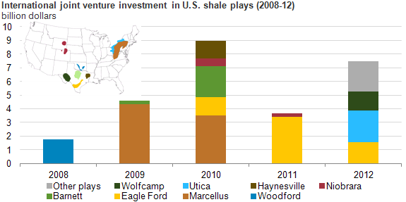
International Interest
Source: EIA, April 8, 2013

Slide 70
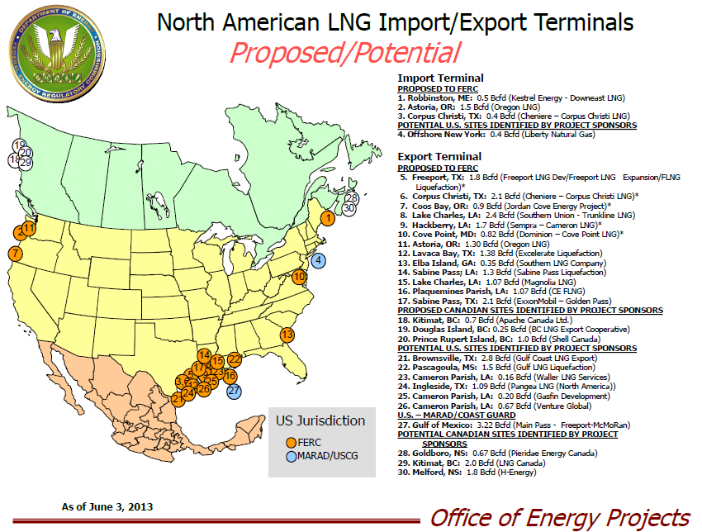
International Interest

Slide 71
THANK YOU!

Slide 72
SS
Some Takeaway Thoughts….

